Slide 1
Canada’s Government
The Basic Structure of the Canadian Government System

Slide 2
Learning Goals
Explain Canada’s basic political structure and the roles of each of the three levels of government

Slide 3
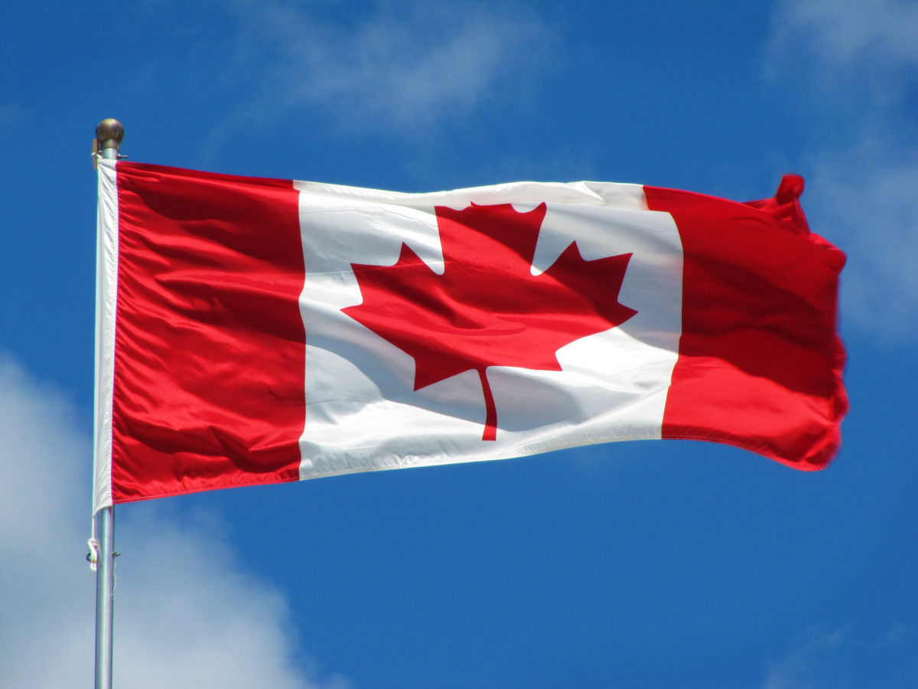
Canada has three levels of government
Federal
National Defense
Foreign diplomacy
International Trade
Aboriginal affairs
Postal Service
Banking System
Marriage and divorce
Criminal law

Slide 4
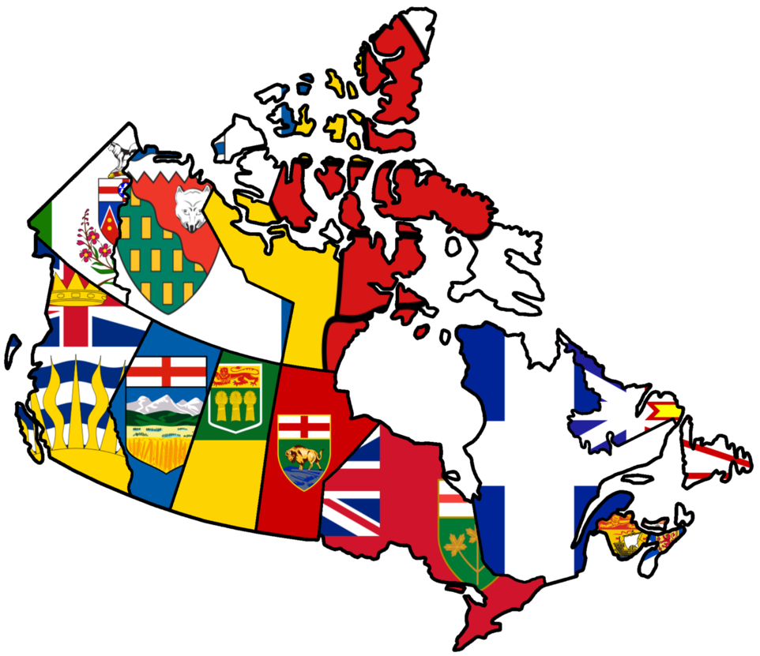
Provincial
Education
Health Services
Some natural resources/ environment
Charities
Licenses
Highways
Provincial court system
Provincial police / prisons

Slide 5
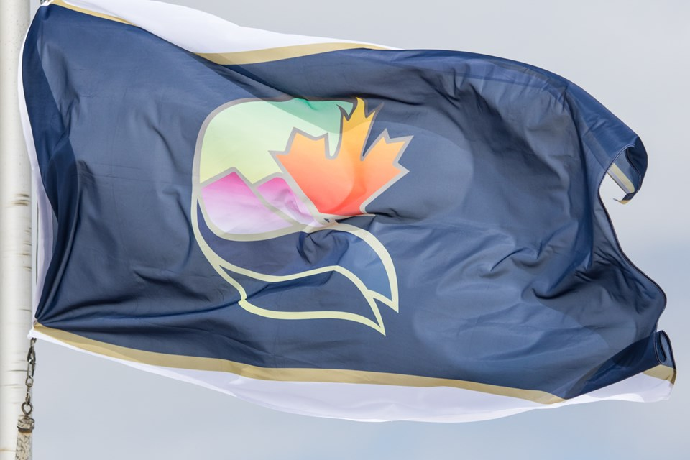
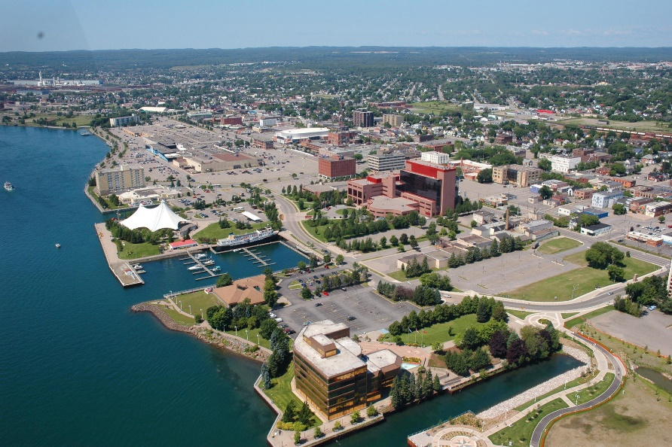
Municipal
Public Transit
Garbage collection and disposal services
Water and sewage
Fire protection services
Zoning land
Local police services
Collection of property taxes and fees for many licenses

Slide 6
Canada’s Government
Canada is a Representative Democracy
A government that is made up of elected representatives who vote and pass laws on the behalf of an area or group
Canada is also a Constitutional Monarchy
A form of government in which a monarch (king or queen) acts as head of state within the guidelines of a constitution

Slide 7
Federal and Provincial Government Structure
Crown/Sovereign Head of state
Structure of the Provincial/ Territorial Governments
Legislative
Structure of the Federal Government
Legislative
Judiciary (Courts)
Executive
Judiciary (Courts
Legislative Assembly
Lieutenant Governor
Lieutenant Governor/ Commissioner
Premier
Cabinet
Ministries and Public Service
Governor General
Primer Minister
Cabinet
Ministries and Public Services
House of Commons
Senate
Governor General
Executive

Slide 8
The three branches of government
Executive
Responsible for carrying out laws and operating the government
Legislative
Discusses the issues of government and passes laws
Judicial
Administer justice through the civil and criminal courts
Interpret and apply the laws

Slide 9
The three branches of Government
Provincial
Legislative - Discusses the issues of government and passes laws
Legislative Assembly
Is composed of the elected representatives of a province or territory. In Ontario they are called Members of Provincial Parliament (MPPs). In some provinces they are called Members of Legislative assembly.
Lieutenant Governor
At the provincial level, they represent the monarch

Slide 10
The three branches of Government
Provincial
Executive - Responsible for carrying out laws and operating the government
Lieutenant Governor- At the provincial level, they represent the monarch
Premier – Head of Government at the provincial level
Cabinet – Made up of members of government chosen by the premier to run ministries
Ministries and Public Services – Responsible for running different parts of government. The public services is staff who the departments and ministries

Slide 11
The three branches of Government
Federal
Legislative -Discusses the issues of government and passes laws
House of Commons
Elected officials debate and pass laws in the chamber.
Senate
Appointed by the Governor General on the advice of the PM. The senate must approve the law for it to pass.
Governor General
At the federal level, they represent the monarch

Slide 12
The three branches of Government
Federal
Executive – Responsible for carrying out lawns and operating the government
Governor General- At the federal level, they represent the monarch
Prime Minister – Head of Government at the federal level
Cabinet – Made up of members of government chosen by the Prime Minister to run ministries
Ministries and Public Services – Responsible for running different parts of government. The public services is staff who the departments and ministries

Slide 13
Legislatures
Legislature
Federal = governor general, the senate, and the House of Commons
Provincial = Lieutenant governor and elected representatives.
Provincial legislature receives it's power from the constitution
Territories receive their power from the federal government

Slide 14
Aboriginal Governments
Canada has over 600 First Nation Bands
Each band has a council who govern the community
Decisions made must still be approved the federal governments

Slide 15
Aboriginal Governments
Elected band officials manage services such as:
Schools and Education
Water and Sewer
By-Laws
Fire Services
Roads, Community Buildings and Organizations

Slide 16
Metis and Inuit
Formed organizations for representation, leadership and promoting their relationship with the federal government.

Slide 17
Aboriginal Government Structure
Ministry of Aboriginal Affairs and Northern Development Canada(AANDC)
Indian Act
Metis
Inuit
First Nations
Band Councils
Band or Chief
Councilors
Metis Nation of Ontario (MNO)
Senators (Elders who represent traditional values and skills)
Community Council Representatives
Executive
Regional Governments of Canada’s 4 Inuit Regions and territories
Inuit Tapiriir Kanatami

Slide 18
Self Governance
Self Governance gives Aboriginal governments powers similar to that of local governments in Canada to demands that Indigenous governments be recognized as sovereign, and capable of "nation-to-nation" negotiations as legal equals to the Crown
Indigenous people do not seek to be "granted" self-government, but simply to have their pre-existing right recognized in law

Slide 19
Implementing Right to Self-Governance
https://www.youtube.com/watch?v=vtJraMegyUI
Anishinabek Nation Self-Government
https://www.youtube.com/watch?v=27OnsrWMlUQ
If the Canadian government acknowledge self governance in law, what would that mean to you and Canada as a whole?
Write a paragraph and hand in.

Slide 20
If the Canadian government acknowledge self governance in law, what would that mean to you and Canada as a whole?
Write a paragraph and hand in.

