Slide 1
Cardiovascular Dynamics
PSK4U
Page 242

Slide 2
Cardiovascular Dynamics
Cardiovascular system adapts to meet the demands that are placed on it
Heart adjusts amount of blood pumped by altering:
Heart rate (HR)
duration of each cardiac cycle
Stroke volume(SV)
Cardiac output (Q)
Frank-Starling Law:
Ability of the heart to stretch and increase the force of contraction
Ejection fraction
Measure of stroke volume calculated by use of a formula

Slide 3
Cardiac Output
Volume of blood pumped out of left ventricle in 1 minute
L/min
5-6L/min at rest
Approximately 30 L/min during exercise
Two factors contribute to Q
Stroke volume and heart rate
HR  SV = Q

Slide 4
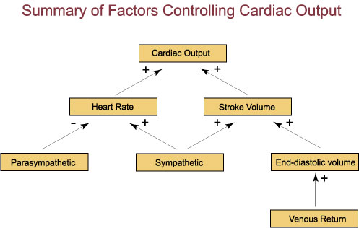
Cardiac Output

Slide 5
Stroke Volume
volume of blood ejected by ventricles
Left ventricle in a single beat
Measured in mL
Calculated by subtracting the
LVESV-left ventricular end systolic volume
Amount of blood remaining in the left ventricle after it contracts
LVEDS-left ventricular end diastolic volume
Amount of blood in the left ventricle before it contracts (after atria contracts)
Capacity to stretch

Slide 6
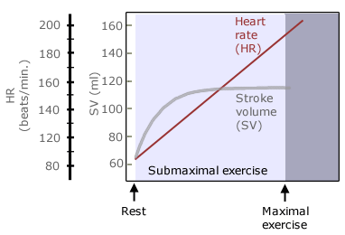
Stroke Volume
SV = LVEDS – LVESV
Regulate by 3 main factors
LVEDV-ability of heart to stretch allows this to increase
Aortic blood pressure
Strength/Force of ventricular contraction
Due to stretching of ventricle and therefore more forceful contraction
Frank Starling Law-Ability of the heart to stretch and increase the force of contraction

Slide 7
Stroke Volume
During exercise venous return increases as the result of 4 factors
1. Constriction of the veins
Smooth muscle in walls of veins is stimulated during exercise
Contracts reducing diameter
Reducing blood volume in veins and directing it to the heart
2. Skeletal muscle pump
3. Thoracic pump
4. Nervous stimulation
Increases heart rate
Increase in force of contraction
Increase in SV

Slide 8
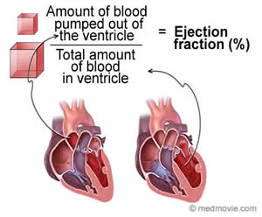
Ejection Fraction
Efficiency of SV
Average EF at rest is 50-60 %
Increases during exercise, up towards 85%
Proportion of blood that is ejected from the left ventricle during a single heart beat
EF(%) = SV (ml) x100
LVEDV (ml)

Slide 9
Heart Rate and Cardiac Output
Number of times a heart contracts in one minute
Beats per minute
Can calculate cardiac output using heart rate
Q (L/min) = SV (ml) x HR (beats/min)
At rest
HR = 72 beats per min
SV = 71 ml
Q = 5040 ml/min = 5.04L/min
During exercise, Q=15-20 L/min
Increase occurs early in exercise and the remains at that level
Due to an increase in SV and HR
Increase in Q is related to the intensity of the exercise

Slide 10
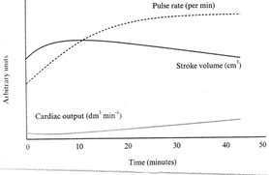
Cardiovascular Drift
Prolonged exercise
SV may begin decline
Due to increase in body temp
Excessive fluid loss due to sweating
Decrease in plasma volume
Redistribution of blood flow to the skin
Dehydration
Lower the venous return, therefore SV may decline
HR begins to increase to compensate for decline in SV
Q stays constant

Slide 11
Blood Pressure
Blood Pressure is the force exerted by the blood against the walls of the arteries
Measuring blood pressure: systolic pressure over diastolic pressure

Slide 12
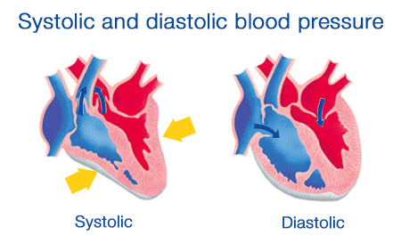
Blood Pressure
Systolic blood pressure:
Pressure observed in the arteries during contraction phase
Diastolic blood pressure:
Pressure observed in the arteries during relaxation phase of the heart

Slide 13
Blood Pressure
Blood pressure changes during exercise
Aerobic activity
Sustained increase in systolic pressure but no change in diastolic
Resistance Training
Short, large increase in both systolic and diastolic
Post-exercise
BP drops below resting level – Post Exercise Hypotension - not for all people

Slide 14
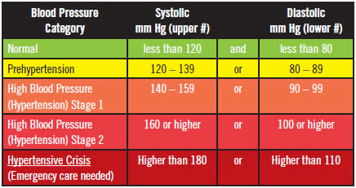
Normal Blood Pressure
Normal blood pressure (BP)
Old Standard 120mmHg over 80mmHg
New Standard-doctors want it lower

Slide 15
Normal Blood Pressure
Hypertension
BP greater than 140mmHg over 90mmHg
Major risk factor for cardiovascular disease
Modifiable-aerobic exercise and diet low in saturated fats and cholesterol as well as high in fibre and complex carbs
May need medication

Slide 16
Normal Blood Pressure
Factors affecting BP
Diet
Aerobic exercise

Slide 17
Blood Flow Distribution
Meet the skeletal muscle demand for O₂
-increase Q
-redistribute blood

Slide 18
Effects of Training (Aerobic)
Alterations to heart structure
Increase in mass and dimension
Increase in ventricular volume and thickness of ventricular walls
Due to increase in venous return
Both contribute to an increase in SV and hence Q
Increase in capillary number that deliver blood to myocardium
Due to increase in oxygen demand
Increase in diameter of coronary arteries

Slide 19
Effects of Training (Aerobic)
Increase in blood volume
Contribute to increase venous return and therefore SV and Q
Increase in RBCs
Training causes Q to increase during exercise but remain unchanged at rest
SV increase during rest and decrease in HR-BRADYCARDIA

Slide 20
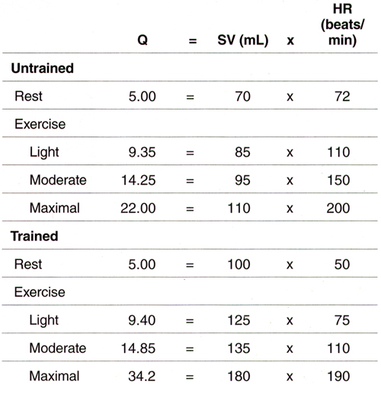
Effects of Training

Slide 21
questions
Page 267 # 3, 4, 11

