Slide 1
Citizenship
ChV2O

Slide 2
Learning Goals
You will be able to describe the responsibilities of Canadian Citizenship
You will be able to describe the rights of Canadian Citizenship
You will be able to discuss the value of citizenship in your own words

Slide 3
Being a good citizen means engaging in your community and taking action to make that community better.

Slide 4
The Oath of Citizenship
“I swear that I will be faithful and bear true allegiance to Her Majesty Queen Elizabeth II, the Queen of Canada, Her Heirs and Successors, and that I will faithfully observe the laws of Canada and fulfill my duties as a Canadian citizen.”

Slide 5
Becoming Canadian: Citizenship
https://www.canada.ca/en/immigration-refugees-citizenship/news/video/becoming-canadian-citizenship.html

Slide 6
Rights and Responsibilities of a Canadian Citizen

Slide 7
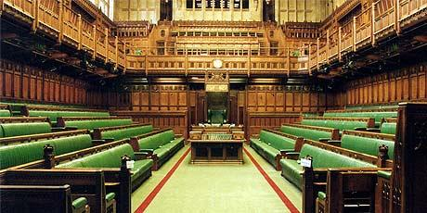
Rights of a Canadian Citizen
Democratic Rights
Every citizen of Canada has the right to vote in an election of members of the House of Commons or of a legislative assembly and to be qualified for membership therein.

Slide 8
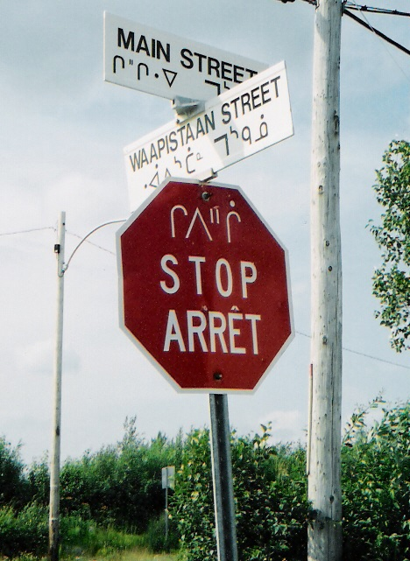
Rights of a Canadian Citizen
Language Rights
The LINC program is funded by citizenship and Immigration Canada you do not have to pay to for LINC classes. LINC provides basic language skills .If you need specific language skills, you may want to consider a program that better fits your educational or career goals.
https://settlement.org/ontario/education/english-as-a-second-language-esl/linc-program/

Slide 9
Rights of a Canadian Citizen
Equality Rights
Every individual is equal before and under the law and has the right to the equal protection and equal benefit of the law without discrimination and in particular, without discrimination based on race, national or ethnic origin, colour, religion, age, mental or physical disability.

Slide 10
Rights of a Canadian Citizen
Legal Rights
Human rights are the minimal rights that each person in Canada, has and holds against other members of society. Every person has the rights to be treated fairly in certain limited areas of their daily lives, in a manner no different from other people.

Slide 11
Rights of a Canadian Citizen
Mobility Rights
Because Canada is a vast country with various economic opportunities distributes throughout its length and breadth, it is important that the right to move, both inside and outside Canadian charter of rights and freedom. It also gives both citizens and permanent residents the rights to move into any province and pursue an economic livelihood.

Slide 12
Rights of a Canadian Citizen
Freedom of Religion
Canadians are therefore free to have their own beliefs and opinions
They are free to practice religion or refrain and are free to establish medial organization with or without religious content.

Slide 13
Responsibilities of Living Canada
Obeying the law:
One of Canada’s founding principles is the rule of law. Individuals and governments are regulated by laws and not by arbitrary actions. No person or group is above the law.

Slide 14
Responsibilities of Living Canada
Taking responsibility for oneself and one’s family
Getting a job, taking care of one’s family and working hard in keeping with one’s abilities are important Canadian values. Work contributes to personal dignity and self-respect, and to Canada’s prosperity.

Slide 15
Responsibilities of Living Canada
Serving on a jury
When called to do so, you are legally required to serve. Serving on a jury is a privilege that makes the justice system work as it depends on impartial juries made up of citizens.

Slide 16
Responsibilities of Living Canada
Voting in elections
The right to vote comes with a responsibility to vote in federal, provincial or territorial and local elections.

Slide 17
Responsibilities of Living Canada
Helping others in the community
Millions of volunteers freely donate their time to help others without pay—helping people in need, assisting at your child’s school, volunteering at a food bank or other charity, or encouraging newcomers to integrate. Volunteering is an excellent way to gain useful skills and develop friends and contacts.

Slide 18
Responsibilities of Living Canada
Protecting and enjoying our heritage and environment
Every citizen has a role to play in avoiding waste and pollution while protecting Canada’s natural, cultural and architectural heritage for future generations.

Slide 19
Thinking about Citizenship – Think-Pair-Share
How can you be a good Citizen?
What does your citizenship mean to you?
In what ways can you improve your community?
How can you motivate others to do the same?

