Slide 1
Energy systems: Training
PSK4U

Slide 2
Each energy system meets the body’s specific needs during activity.
Knowledge of these energy systems should affect the training methods of athletes based on the needs of their sport.
This type of training allows the athletes to be best prepared for their sport, and gives their limited training time a better focus.

Slide 3
Anaerobic Alactic (ATP-PC)
All training for this system should be powerful (100% intensity) and short (6-12s).
The recovery time for this system should be minimal (15s-120s).

Slide 4
ATP-PC Examples
Running – 10 repetitions of 30m sprints with 30s recovery
Strength Training – 4 repetitions of 90% maximum load with 30s recovery
Swim – 8 repetitions of 25m sprints with 30s recovery

Slide 5
Effects of training on Anaerobic Alactic system:
20-40% increase of creatine phosphate stores
increase of ATP stores
increase in creatine kinase function

Slide 6
Anaerobic lactic (Glycolysis)
Training for this system should be fairly powerful (70-95% intensity) and a longer timeframe than immediate alactic training (12s-3 min.).
The recovery time for this system is also longer (45s-180s).

Slide 7
Examples
Running – 5 repetitions of 300m sprints with 60s recovery
Strength Training – 10 repetitions of 70% maximum load with 60s recovery
Swim – 5 repetitions of 200m sprints with 60s recovery

Slide 8
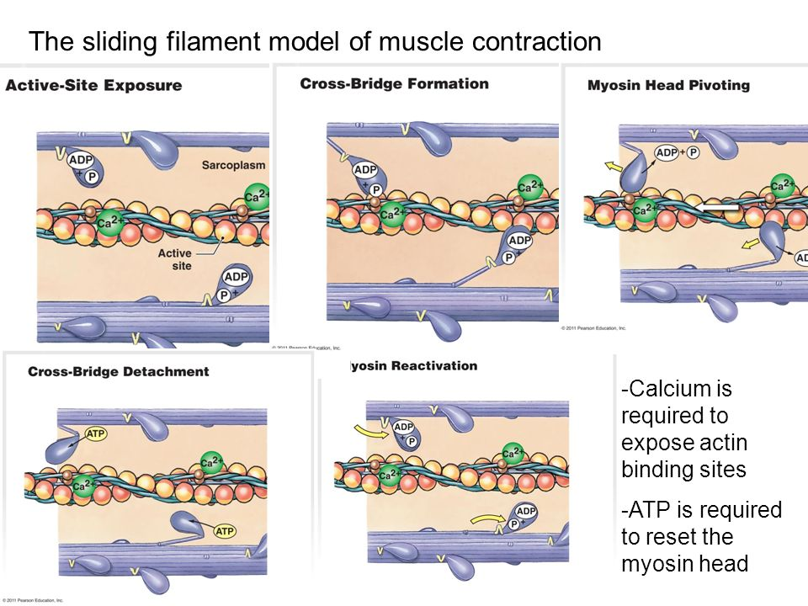
Why does lactic acid inhibit muscle contraction?
An increase in lactic acid causes a release of hydrogen ions, which inhibit calcium from binding to tropomysosin, so actin binding sites are still blocked.

Slide 9
Why does lactic acid inhibit muscle contraction?
The hydrogen ions cause the muscles to become acidic. The acidity slows the breakdown of glucose, and aggravates nerve endings.
The pain and irritation reaches the central nervous system and is the reason why some athletes feel disoriented or nauseous after exercise.
Do not confuse this with exhaustion.

Slide 10
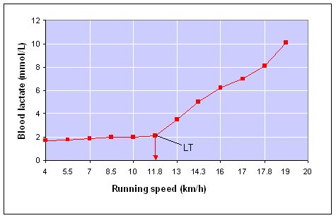
When does this occur?
Inhibited muscle contraction occurs when anaerobic threshold is reached. Anaerobic Threshold (AT) is the point at which the lactic acid is accumulating in the blood stream.

Slide 11
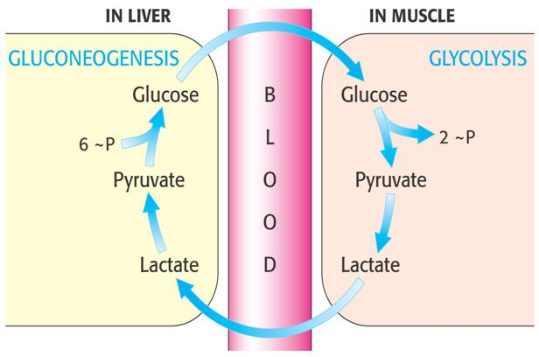
The production of lactic acid is too great for the removal of the lactic acid via the Cori cycle to keep up.

Slide 12
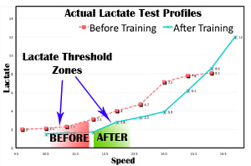
When this point is reached, the release of hydrogen ions will cause the acidity in the muscle. Trained athletes have a higher AT (at 80-90% of max. effort) while untrained athletes have a lower AT (~55% of max. effort).

Slide 13
Effects of training on short term lactic acid system:
Enables oxygen system to be utilized sooner to limit lactic acid production
Increases lactic acid removal from muscles
Increases speed of conversion of lactic acid into glucose

Slide 14
Aerobic (Cellular Respiration)
Training for this system should be low to moderate intensity (40-70% intensity) and have a long timeframe (3 min.- 180 min.).
The recovery time for this system is the longest (90s – 12 hours).

Slide 15
Examples:
Running – 5k run or 30 minute continuous run
Strength Training – Circuit training at a low intensity
Swim – 1500m swim or 30 minute continuous swim

Slide 16
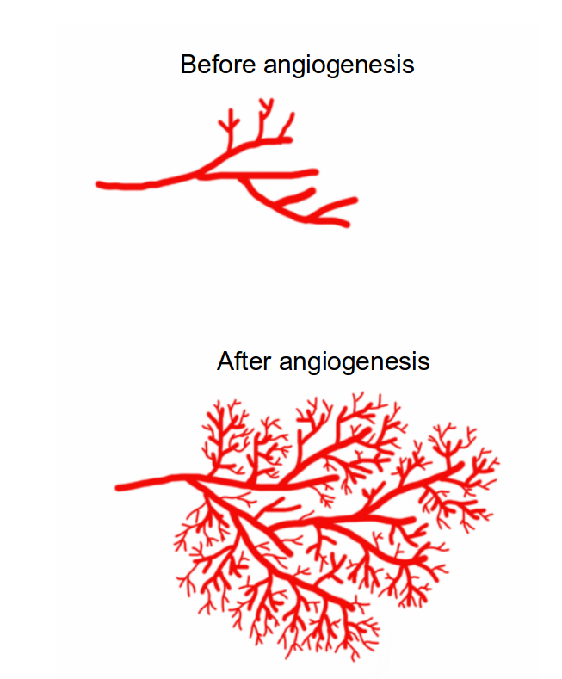
Effects of training on aerobic system:
Increase in vascularization (# of blood vessels) within muscles. (Angiogenesis)

Slide 17
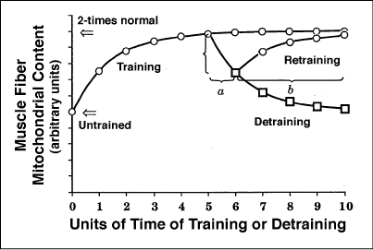
Effects of training on aerobic system:
Increases size and number of mitochondria in muscle.

Slide 18
Effects of training on aerobic system:
Increases enzyme activity involved in aerobic system.
Use of fats rather than glycogen for energy.

Slide 19
Think, Pair, Share
You will pick 2 athletes from the ones given. Think about what training each athlete will need. Pair up with someone else who has that athlete Share with the class our thoughts. Provide sound reasoning for your given training methods.
Does your athlete need to train more than one type of energy system? Explain.

Slide 20
Athletes to pick from:
Long Distance Cyclist
Hockey Player
MMA Fighter
Volleyball Player
Rec league vs Pro level
Professional Cross fit athlete

