Slide 1
Outdoor Education
The Lost Victim

Slide 2
Fill in the highlighted words into your copy of the handout

Slide 3
When lost in the wilderness, many people choose to walk around and try to find their way out.
However, you MUST remember that it takes Twice as much food (energy) to travel as it does to sit and wait at your shelter.

Slide 4
Remember, that survival is 80% mental, and 20% skills.
Many people feel that being found sitting and waiting doesn't seem like the "manly" thing to do, however, it may increase your chance to Survive.

Slide 5
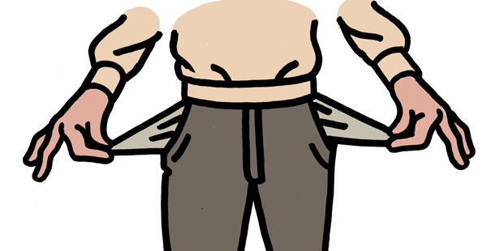
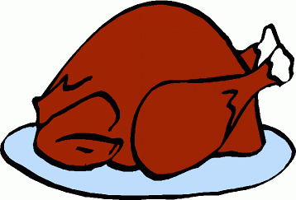
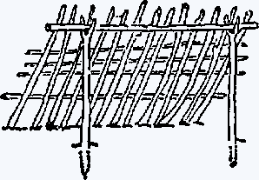
Draw this on your page to help you remember what to do
5. Food
You're Lost
1.
Empty Pockets
4. Fire
2. Build Shelter
3. Find Water

Slide 6
1. Empty Pockets
- Dry Matches, food, Knife?
2. Build a Shelter
- Warm, dry, comfortable
- In bad weather, you won't last long.

Slide 7
3. Keeping hydrated keeps you Healthy and Ready
4. Fire – collect wood that is farther from you so that when you are tired, you can collect wood that is closer to you.
- Also use fire as a SIGNAL!!

Slide 8
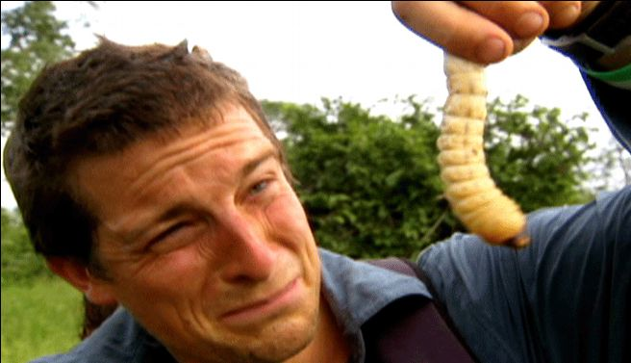
5. Food – Not a necessity right away
- you can go a long time without it.

Slide 9
Questions
Why is food last?
Why is it said that survival is 80% mental and 20% skill?
Why do people wander around when they are lost?

Slide 10
Activity
In groups of three plan out the following scenario
Scenario
You and your companions have just survived the crash of a small plane. Both the pilot and co-pilot were killed in the crash. It is mid-January, and you are in Northern Canada. The daily temperature is 25 below zero, and the night time temperature is 40 below zero. There is snow on the ground, and the countryside is wooded with with several creeks criss-crossing the area. The nearest town is 20 miles away. You are all dressed in city clothes appropriate for a business meeting. Your group of survivors managed to salvage the following items:
A ball of steel wool
A small ax
A loaded .45-caliber pistol
Can of Crisco shortening
Newspapers (one per person)
Cigarette lighter (without fluid)
Extra shirt and pants for each survivor
20 x 20 ft. piece of heavy-duty canvas
A sectional air map made of plastic
One quart of 100-proof whiskey
A compass
Family-size chocolate bars (one per person)
Your task as a group is to list the above 12 items in order of importance for your survival. List the uses for each. You MUST come to agreement as a group.

