Slide 1
Political Parties and the Political Spectrum
CHV2O

Slide 2
Political Parties
Most elected politicians at the provincial and federal level belong to a political party.

Slide 3
Political Parties
Political Party – An organization of people with similar values and beliefs who seek to influence or control the government by winning elections.

Slide 4
How do political parties work?
https://www.youtube.com/watch?v=-XlUICruITE

Slide 5
Party Platform
Party Platform – A set of ideas and promises created during an election campaign to explain a political party’s position on important issues.

Slide 6
Political Spectrum
A system for classifying political beliefs, often on a left-to-right scale.
Parties in the middle are deemed more moderate.

Slide 7
Political Spectrum
Parties to the left of center are deemed more socialist
Parties to the right of center are deemed more conservative
Parties at either far end are deemed extreme.

Slide 8
Political Spectrum
Left Centre Right
Socialist Conservative

Slide 9
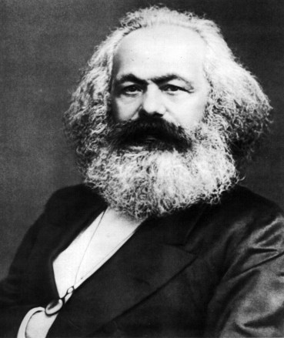
Political Spectrum
Socialist – Political philosophy that promotes equal rights to education, medical care, employment, safe working conditions, and that supports the power of the government to ensure economic equality.

Slide 10
Political Spectrum
Conservative – Political philosophy that promotes lower taxes, increased private business, and a respect for tradition, and that supports individual freedom through a limited government role.

Slide 11
Political Ideology
Political Ideology - A set of beliefs about how society should work and about the role of government in relation to economic, social, and moral affairs.

Slide 12
Political Spectrum
Left Centre Right
Socialist Conservative

Slide 13
Libertarianism
- A collection of political philosophies and movements that uphold liberty as a core principle. Libertarians seek to maximize political freedom and autonomy, emphasizing freedom of choice, voluntary association and individual judgment

Slide 14
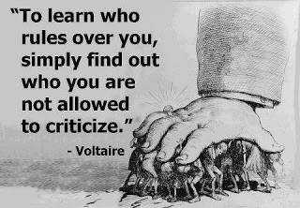
Authoritarianism
- a form of government characterized by strong central power and limited political freedoms. Individual freedoms are subordinate to the state and there is no constitutional accountability and rule of law under an authoritarian regime

Slide 15
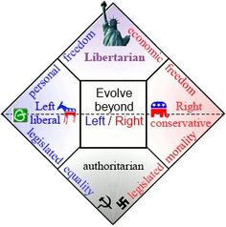

Slide 16
Platforms of Canada’s Main Political Parties
Conservative Party
Believes in a smaller, limited government
Supports lower taxes for people and businesses

Slide 17
Platforms of Canada’s Main Political Parties
Conservative Party
Less supportive of environmental initiatives
In favour of increased spending on the military
Believes in harsher treatment of those who break the law

Slide 18
Platforms of Canada’s Main Political Parties
Liberal Party
Supports a balance between the public sector and private business
Socially progressive: supports changes in traditional values
Supports social programs such as health care and old age pension

Slide 19
Platforms of Canada’s Main Political Parties
New Democratic Party
Promotes economic equality
Supports spending on social programs

Slide 20
Platforms of Canada’s Main Political Parties
New Democratic Party
In favour of taxing large corporations and the wealthy
Supports a wide range of human and civil rights
Has ties to organized labour, such as unions

Slide 21
Other Political Parties in Canada
Bloc Quebecois
Believe in the Quebec Nationalism, Quebec Sovereignties, and Social Democracy
Pro, Environmentalist, same sex marriage, abortion rights, legalization of assisted suicide and finialy the abolition of the Canadian Senate.
Left of Centre

Slide 22
Other Political Parties in Canada
The Green Party of Canada
Sustainability: protect the environment through the use of renewable resources
Social Justice: equitable distribution of resources to ensure that all have full opportunities for personal and social development.
Direct Democracy: all citizens have the right to express their views, and are able to directly participate in decisions which affect their lives.

Slide 23
Other Political Parties in Canada
Rhinoceros Party
Canada’s most famous satirical political party, known for proposing odd platforms over the years
Platform Promises
1. Take Canada off the gold standard, opting instead to use a snow standard to boost the economy. (And then, when summer comes . . . not sure yet.)
2. Repeal the law of gravity.
3. Provide higher education by building taller schools.
4. Pave the Bay of Fundy to make more parking for the Maritimes.

Slide 24
Other Political Parties in Canada
Pirate Party of Canada
focuses on issues such as open government, the protection of privacy and patent reform

Slide 25
Other Political Parties in Canada
Libertarian Party of Canada
stands for free market economic policies, including a gradual phase out of government control over the money supply

Slide 26
Other Political Parties in Canada
Communist Party of Canada
Driven by Marxist and Leninist Values
Calls for policies such as a massive housing program, protected labour rights and the nationalization of energy, natural resources and banks

Slide 27
Other Political Parties in Canada
Animal Alliance Environment Voters Party of Canada
Aims to give environment and animal protection issues political relevance, and to hold federal politicians accountable for related policies.

Slide 28
Kahoot
https://create.kahoot.it/share/political-spectrum-canada/df1cfc45-cebe-474b-b03b-b0feefe7bef9

