Slide 1
Respiratory Dynamics
PSK4U

Slide 2
Respiratory Dynamics
During exercise the body demands more oxygen
To meet these demands the body has a series of responses
Changes to:
Pulmonary Ventilation
External Respiration
Internal Respiration

Slide 3
Pulmonary Ventilation (V_{E})
Matched to rate/intensity of work being done
Increase in V_{E} during sub-maximal exercise has 3 phases
Phase 1
Rapid on phase
Immediate increase in V_{E}, almost immediately with onset of exercise
Phase 2
Slower exponential increase
Phase 3
Levelling off of V_{E} at a new steady state

Slide 4
Pulmonary Ventilation (V_{E})
New steady state is determined by:
Fitness of individual
Intensity of exercise
Initial increase is due to increase in V_{T} but then f increases as well

Slide 5
External Respiration
External respiration is the result of two main factors:
Increase in pulmonary ventilation (V_{E})
Matched closely in the increase in requirements of working skeletal muscles
Maintains necessary gradients in the partial pressures of both O₂ and CO₂
Increase in blood flow to the lungs
Caused by and increase in cardiac output

Slide 6
Flow of External and Internal Respiration

Slide 7
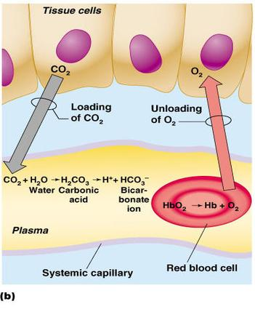
Internal Respiration
Internal respiration involves exchange of gases at tissue level
Extraction of O₂ at tissues is increased as a result of four main factors:

Slide 8
Internal Respiration
1. Increase in partial pressure of oxygen (PO₂) gradient
During exercise O₂ is used to generate ATP
Use of oxygen reduces the amount O₂ in skeletal muscles
Increases the gradient, which enhances the diffusion of O₂ out blood into muscle

Slide 9
Internal Respiration
2. Increase in partial pressure of carbon dioxide (PCO₂)
Increase in muscle activity increase CO₂ production
3. Decrease in pH
Due to increase in CO₂ and lactic acid
4. Increase in temperature

Slide 10
Internal Respiration
3 factors effect binding of O2 to Hgb and result in increase in the unloading of O₂
Increase in CO₂
decrease in pH
increase in temperature.
Bohr shift-shift left of the oxyhemoglobin dissociation curve
Greater amount of O2 will be unloaded for a given PO₂

Slide 12
a-vO2 Difference -difference in the amount of O2 in the artery and vein -reflects the amount of O2 delivered to the muscle

Slide 13
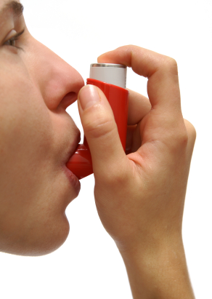
Asthma
Asthma (acute or chronic) is characterized by:
Spasm of smooth muscle lining the respiratory system
Oversecretion of mucous
Swelling of cells lining the respiratory tract
Asthma results in:
Dyspnea (shortness of breath)
Wheezing during breathing
Acute or Chronic
Factors that stimulate attacks:
Exercise
Allergic reactions/contaminates
Stress
Controlled through the use of medications
© iStockphoto.com/”TommL”

Slide 14
Chronic Obstructive Pulmonary Disease
Chronic obstructive pulmonary disease (COPD):
Describes a family of diseases that lead to a reduction in airflow through the respiratory system
Often fatal in severe cases
Persistent conditions cannot be relieved (quickly or effectively) through the use of medications
Individuals experience dyspnea while performing everyday activities
Treatment includes:
Medication
Oxygen therapy
Respiratory muscle training

Slide 15
Oxygen Consumption VO₂
Amount of O₂ taken up and consumed by body for metabolic processes
Amount of O₂ inspired minus O₂ expired
Proportional to workload
Greater that workload the greater the VO₂
Greater the amount of O₂ used by the body

Slide 16
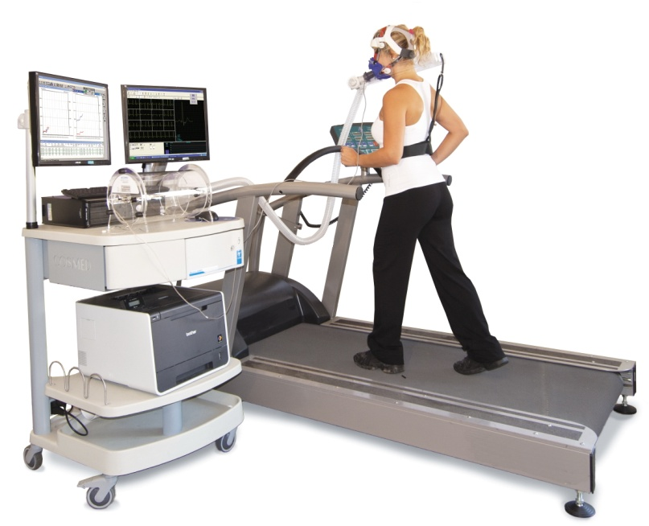
Oxygen Consumption VO₂
Measured using a metabolic cart and indirect calorimetry
Indicator of fitness
Function O2 uptake and O2 delivery
VO₂ (L/min)
= [volume of inspired (L/min) x % O₂ inspired] – [volume of expired (L/min) x %O₂ expired]

Slide 17
Oxygen Consumption VO₂
Cardiac Output (Q) is another way to describe O₂ delivery
Q is the total blood flow throughout the body
Another way to describe O2 uptake is a-vO₂diff
Represents the amount of O2 found in the arteries minus the average amount in the vena cava
VO₂ (L/min) = Q x [a-vO₂diff ]
VO₂ (L/min) = (SV x HR) x [a-vO₂diff ]

Slide 18
Maximal Rate of Oxygen Consumption
VO_{2max}
Theoretically occur at max SV, HR and a-vO₂diff
Maximal amount of O2 that can be taken in and used for the metabolic production of ATP during exercise
Calculated by a metabolic cart
Participant performs incremental exercise until exhaustion
http://www.youtube.com/watch?v=stFJesbRsVI

Slide 19
Oxygen Consumption VO₂
VCO₂ Production of CO₂
Calculated by measuring the difference between the amount of CO₂ expired and the amount inspired
VO₂ and VCO₂ can be provide information about individual in relation to exercise
Together they provide more information

Slide 20
Oxygen Consumption VO₂
Ratio between VO₂ and VCO₂ is used to calculate
RER
Respiratory exchange ratio
Indicates what metabolic system is being used within working muscle
RER = 1 for carbs
RER = 0.7 for fat

Slide 22
Limiting Factors for VO₂ max
Respiratory System
Inadequate ventilation
Oxygen diffusion limitations
Metabolic System within the working muscle
Lack of mitochondria
Cardiovascular System
Inadequate blood flow, cardiac output or oxygen carry capacity (Hgb)
Most research indicates this is the major limiting factor in healthy people
Unable to meet demands of the working muscle and deliver adequate amounts of O₂

Slide 23
Ventilatory Threshold
During incremental exercise pulmonary ventilation increases proportionally to the increase in workload
Ventilatory threshold
Point where ventilation increases much more rapidly than workload
Occurs at 65-85 mx VO₂
Occurs because of an increase in lactic acid in the blood
Body’s demands could not be met by the aerobic system alone
Increase in ventilation is the body’s response to deal with the drop in pH
Ventilatory threshold is used as a marker of an increased reliance on anaerobic metabolic systems

Slide 24
Lactate Threshold
Lactate Threshold
-closely associated with ventilatory threshold
-point where blood lactate levels begin to rise
-accumulation is greater than elimination

Slide 25
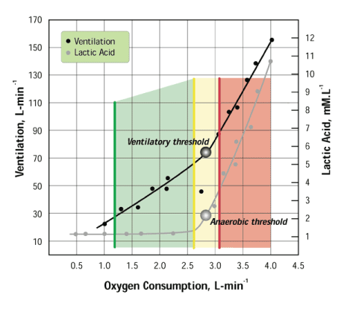

Slide 26
Secondary Ventilatory Threshold
Hyperventilation
Ventilatory threshold (T_{vent})
Inflection point where V_{E} increases exponentially

Slide 27
Lactic Acid Accumulation
Hypothesized causes
Increased reliance on anaerobic metabolism
Decreased oxygen delivery to working muscles
Decrease in muscle blood flow
Can occur between 65-85% VO_{2max} depending on individual's fitness and type of exercise

Slide 28
Oxygen Deficit
Lag phenomenon
Time required for you body reach a new steady state
During this period working muscles must rely on metabolic systems that do not require oxygen
O.D.-difference between the oxygen required to perform a task and the oxygen actually consumed prior to reaching a new steady state
Plateau where HR and oxygen uptake level off
Energy demand and energy production are evenly balanced

Slide 29
Oxygen Deficit and EPOC

Slide 30
Exercise Post-Exercise Oxygen Consumption
Period of time following intense physical exercise before the body returns to resting state
Recovery period where excess oxygen is taken in
Replenish oxygen in systems that were taxed
Phosphocreatine reserves in muscles
Oxygen in blood and tissue
Lowering elevated HR and breathing
Lowering body temp
Increasing blood lactate removal

Slide 31
Physiological Adaptations Due to Endurance Training

Slide 32
