Slide 1
Roles within the Government
CHV2O

Slide 2
Review of Levels of Government Kahoot
https://create.kahoot.it/share/duplicate-of-canadian-government/8aa0c07c-5b9a-40d0-8f0d-eda4c5b6dfbf

Slide 3
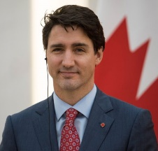
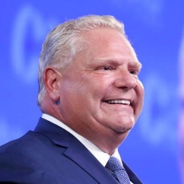
Prime Minister and Premier
Prime Minister | Premier
Heads of government Leaders in their political parties Responsible for choosing their Cabinets Responsible for running their Cabinet meetings Responsible for maintaining the confidence of the legislature

Slide 4
Cabinet Ministers
Members of the government who are responsible for running parts of the government, called ministries.
They are appointed by either the Prime Minister (Federal) or premier (Provincial).

Slide 5
Cabinet Ministers
The cabinet sets and carries out government policies.
Ministers act as advisors to the Prime Minister or premier

Slide 6
Ministries
Federal Ministers |  | Provincial Ministers
Justice | Foreign Affairs | Aboriginal Affairs | Health
Environment | Multiculturalism | Attorney General | Energy
Defence | Economic Development | Consumer Services | Environment
Natural Resources |  | Education

Slide 7
Members of Parliament (MPs) and Members of Provincial Parliament (MPPs)
MPs and MPPs have similar roles and responsibilities
Participate in the creation of legislation, laws of the country or province
Make and vote on bills

Slide 8
Members of Parliament (MPs) and Members of Provincial Parliament (MPPs)
Some sit on committees that consider bills. They ask questions of individuals and groups affected by proposed legislation
Caucus: meetings held in private by parties to discuss issues and parliamentary strategy

Slide 9
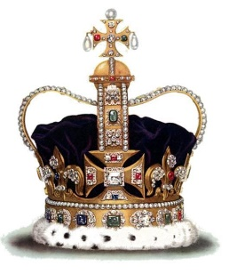
Role of the Crown
The crown is represented by the lieutenant governor at the provincial level and the governor general at the federal level

Slide 10
Role of the Crown
Role of the Lieutenant Governor | Role of the Governor General
Dissolves, prorogues, and summons the legislature at the premiers request Reads the speech from the Throne | Dissolves, prorogues, and summons the Parliament at the Prime Ministers request Reads the speech from the Throne

Slide 11
Role of the Crown
Role of the Lieutenant Governor | Role of the Governor General
Swears in the premier, ministers and other officials Grants Royal Assent to make bills into laws Advises the premier | Swears in the Prime Ministers, ministers and other officials Grants Royal Assent to make bills into laws Advises the Prime Minister

Slide 12
Role of the Crown
Role of the Lieutenant Governor | Role of the Governor General
 | - Visits foreign nations as an ambassador and representative of the head of state - Receives and welcomes foreign ambassadors and dignitaries

Slide 13
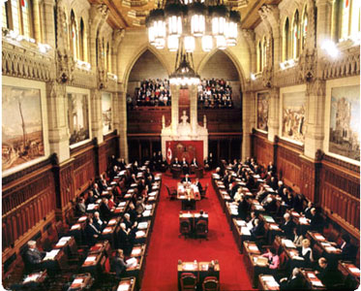
The Senate
Members are appointed by the Governor General, on the recommendation of the Prime Minister.

Slide 14
Roles of the Senate
Reviewing Laws
Review laws that are made in the House of Commons, and to suggest how these laws could be improved
They can also introduce bills to be passed into laws

Slide 15
Roles of the Senate
Representing Regional Interests
Senators are appointed from each region. This limits the power of more populated areas of the country.

Slide 16
Roles of the Senate
Providing Stability to the Government
Senate members are appointed to serve until the age of 75
Members do not have to be re-elected
This allows them to concentrate on the business of the government and not on party politics

Slide 17
Roles of the Senate
The Senate has become an important institution for the representation of minority interests and groups who may be underrepresented in the elected chamber.

Slide 18
YouTube clips
About the senate
https://www.youtube.com/watch?v=rSjq72k4TpM
Abolish the Senate?
https://www.youtube.com/watch?v=FyOrRG-15ck

Slide 19
Think/Pair/Share
What purpose does the Senate serve?
Why are the senators are not elected every few years?
Why would some people want to abolish the senate?
Does the senate seem democratic to you?

