Slide 1
Solubility (page 314 - 326)
December 14th, 2011
Lesson 4

Slide 2
Today’s Agenda
Explanation of how to answer question # 2 of the lab
Note
Questions
Reading
We will complete the lab tomorrow ☺

Slide 3
Question # 2
What is the V/V concentration acetic acid if 50 mL of acetic acid is added to 50 mL of water? The acetic acid is already 5% V/V. Make the solution
First you need to the volume of acetic acid in 50 mL of the acetic acid.
V_{Solution} _{acetic acid} = 50 mL
C_{acetic acid} = 5%
V_{acetic acid} = ?

Slide 4
= 2.5 mL
Now calculate the concentration of the new solution
V_{Solution} _{acetic acid} = 100 mL
V_{acetic acid} = 2.5 mL
C_{acetic acid} = ?

Slide 5
= 2.5% concentration
Therefore, the final concentration of the acetic acid solution would be 2.5% V/V.

Slide 6
Solubility

Slide 7
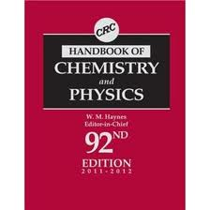
Solubility of Solids
Every pure substance has specific solubility which can be found by looking in the CRC Handbook of Chemistry.
The value that it states indicates the specific number of grams of solid that will dissolve in 100 mL of water, this is different than ending with 100mL of solution.

Slide 8
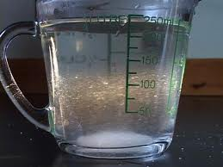
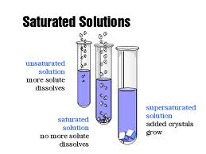
If there are undissolved solids in the solution, the solution is not standard but saturated for that specific temperature.

Slide 9
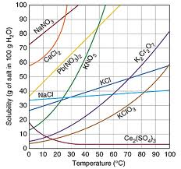
Solubility Curves (Page 316)
Used to indicate how much solid of a specific substance can dissolve in 100 mL of water.

Slide 10
The amount of substance that will dissolve will increase or decrease, depending on what the solute is.
Example Ce₂(SO₄)₃ vs CaCl₂
See page 316 for a better table than the one in the note

Slide 11
To use the table, the compound and specific temperature are used to locate the maximum of solute that be dissolved

Slide 12
Example
How much solid KNO₃ can be dissolved in 2.5 L of water when the water has a temperature of 44 ° C?
V = 2.5 L = 2500mL
T = 44° C
m_{KNO3} = ?

Slide 13
m = 1.8 kg
Therefore, 1.8 kg of solid KNO₃ can be dissolved in 2.5 L of water at 44 °C.

Slide 14
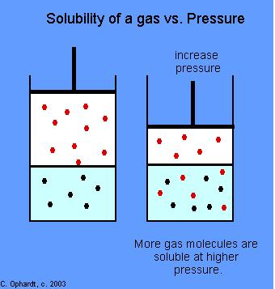
Solubility of Gases
Gases can also dissolve in liquids but their ability to dissolve is dependent on pressures above them.
A higher pressure will force gas molecules into the liquid, in doing so gas dissolves and the gas pressure decreases.

Slide 15
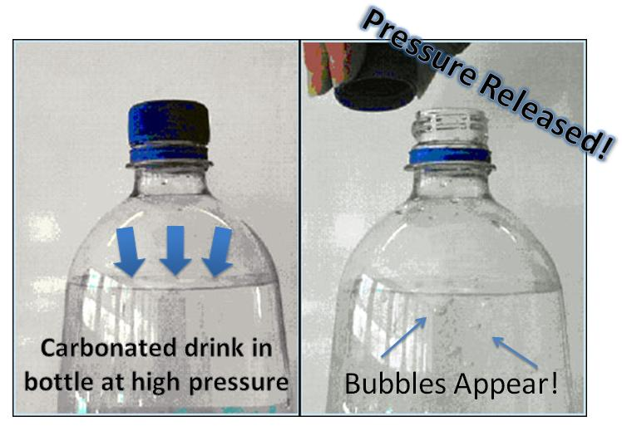
Example –
Opening a can pop, once the pressure is released the gas comes out of solution.

Slide 16
The BENDS
Deep sea divers may experience a condition called the "bends" if they do not readjust slowly to the lower pressure at the surface. As a result of breathing compressed air and being subjected to high pressures caused by water depth, the amount of nitrogen dissolved in blood and other tissues increases.

Slide 17
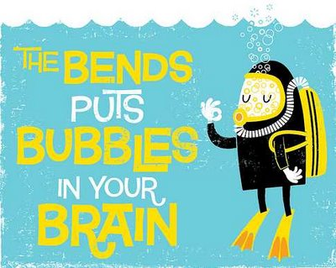
If the diver returns to the surface too rapidly, the nitrogen forms bubbles in the blood as it becomes less soluble due to a decrease in pressure. The nitrogen bubbles can cause great pain and possibly death

Slide 18
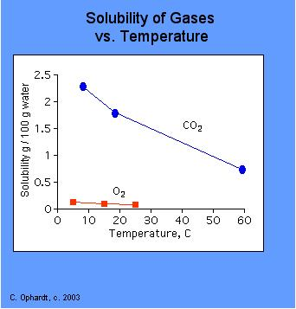
Temperature also dramatically effects how well gasses dissolve.
Lower temperatures increase solubility where higher temperatures decrease solubility.

Slide 19
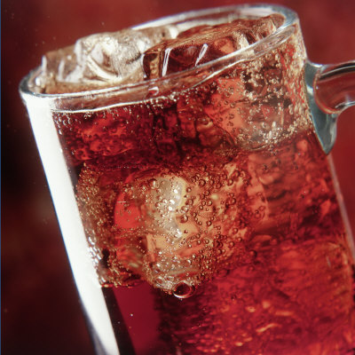
Example
Cold pop retains its carbonation longer than warm pop.

Slide 20
Solubility in Water – Generalizations
Solids generally are more soluble in water at higher temperatures. This is generally the case with molecular compounds. There are some exceptions.
Gases are more soluble in water at lower temperatures.
Temperature has some effect on polar liquids dissolving in water but not nearly as great as liquids or solids.

Slide 21
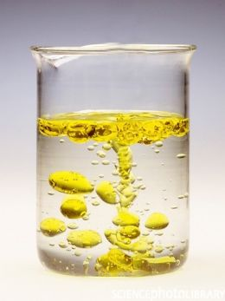
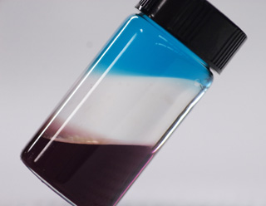
Non-polar liquids do not dissolve in water and are said to be immiscible.
Two liquids that from separate layers instead of dissolving.

Slide 22
Liquids that have small polar molecules with hydrogen bonds will completely dissolve in water in any ratio are said to be miscible.
Liquids that mix in all proportions and have no maximum concentration
Elements generally have low solubility in water

Slide 23
Solubility Categories (P 323)
High Solubility – with a maximum concentration at SATP (standard ambient temperature and pressure) of greater than or equal to 0.1 mol/L
Low Solubility – with a maximum concentration of SATP of less than 0.1 mol/L

Slide 24
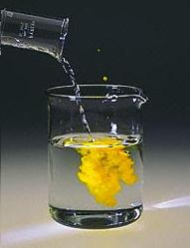
Insoluble – a substance that has a negligible solubility at SATP
Precipitate – The solid formed in a chemical reaction or by decreased solubility

Slide 25
Double displacement reactions will form precipitates – table page 324
Look at the anion part of the table and locate one of the anions in the table. Then look at what cations are listed below it.
If the cation is in the highly soluble section then the molecule will be dissolved in the solution.
If the cation has low solubility, it will form a precipitate.

Slide 26
Example –
Will the reaction happen? If so, which product will be the precipitate?
Pb(NO₃)₂ + 2KI → PbI₂ + 2KNO₃
I⁻ and Pb²⁺ have low solubility and form a precipitate.
NO₃⁻ and K⁺are soluble in solution
Pb(NO₃)_{2 (aq)} + 2KI _{(aq)} → PbI_{2 (s)} + 2KNO_{3 (aq)}

Slide 27
Questions
Page 316 # 1-2
Page 318 # 4-5
Page 319 # 6, 8
Page 325 # 11-12
Read page read 362 - 374,

Slide 28
Questions
Thermal pollution is merely waste heat that has been transferred to water or air. How is the concentration of dissolved oxygen in water be effected by thermal pollution?
Warmer water contains less dissolved O₂

Slide 29
If a diver had the "bends", describe how this can be treated.
Decompression chambers are used to maintain a higher pressure that is slowly decreased.

Slide 30
The amount of dissolved oxygen in a mountain lake at 10,000 ft and 50ºF is __?_ than the amount of dissolved oxygen in a lake near sea level at 50ºF
Less at higher altitude because there is less pressure

Slide 31
A Coke at room temperature will have __?_ carbon dioxide in the gas space above the liquid than an ice cold bottle.
More gas, because the warm coke can hold less gas in solution.

Slide 32
Hyperbaric therapy, which involves exposure to oxygen at higher than atmospheric pressure may be used to treat hypoxia (low oxygen supply in the tissues). Explain how the treatment works.
The increase in pressure in the chamber will cause more O2 gas to enter the lungs and go into the blood stream.

