Slide 1
Mixtures of gases
Lesson 7

Slide 2
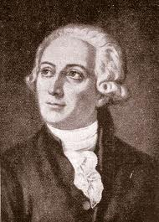
Mixtures of Gases
300 years ago air was thought to be one compound.
Antoine Lavoisier (1743-1794) discovered that air was actually made up of at least two gases.
One that supported combustion and one that did not, this later lead to conservation of mass.

Slide 3
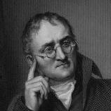
John Dalton (1766-1844) proposed that gas particles act the same whether they are independent or in a mixture.

Slide 4
After conducting a series of experiments he deducted that each individual gas contributes to the total gas pressure.

Slide 5
He also found that while the percent composition of the air did not change for gases such as O₂, CO₂, and N₂.
Water vapour pressure would change depending on the temperature, regardless if it was by itself or in a mixture. .

Slide 6
Table: Composition of Dry Air at Sea Level
Component | N₂ | O₂ | Ar | CO₂ | Ne | He | CH₄ | Kr | H₂ | N₂O | Xe
Mole Percent | 78.08 | 20.948 | 0.934 | 0.0314 | 0.001818 | 0.000524 | 0.002 | 0.000114 | 0.00005 | 0.00005 | 0.0000087
Molar Mass | 28.013 | 31.998 | 29.948 | 44.010 | 20.183 | 4.003 | 16.043 | 83.80 | 2.016 | 44.013 | 131.30

Slide 7
Dalton’s Law of Partial Pressures

Slide 8
Dalton’s Law of Partial Pressures
When Dalton was conducting his studies, which led him to the atomic-molecular theory of matter, he also included studies of the behaviour of gases. These led him to propose, in 1803, what is now called Dalton's law of partial pressures:
Partial Pressures - The pressure, p, that a gas in a mixture would exert if it were the only gas in the same volume, at the same temperature.

Slide 9
Dalton’s Law of Partial Pressures
Dalton law states that
the total pressure of a mixture of non-reacting gases is equal to the sum of the partial pressures of the individual gases.

Slide 10
Dalton’s Law of Partial Pressures
The laws equation is expressed as:
P_{total} = P₁ + P₂ + P₃ + ...
Where P_{total} is the total pressure of the mixture and P₁, P₂, and P₃ are the partial pressures each has in the mixture.

Slide 11
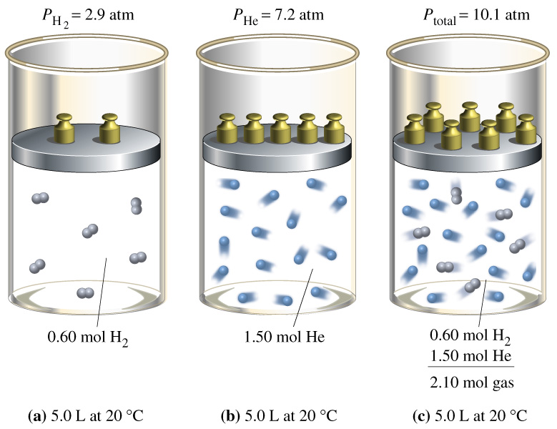
Dalton’s Law of Partial Pressures

Slide 12
This law can be explained by the molecular kinetic theory, the type of gas particle doesn’t matter because they are all behaving in the same manner. They are all consistently moving, and colliding with each other and with the walls of the container.

Slide 13
The law is based on two concepts.
The pressure of a gas is caused by the collisions with the walls of the container.
Gas molecules act independently of each other.

Slide 14
Example
The air that we are breathing right now is primarily composed of nitrogen, oxygen and carbon dioxide. What is the air pressure in this room if the following pressures occur? N₂ = 79.03 kPa, O₂ = 21.28 kPa and CO₂ = 1.01 kPa.

Slide 15
G | N₂ = 79.03 kPa O₂ = 21.28 kPa CO₂ = 1.01 kPa | S | P_{total} = 79.03 kPa + 21.28 kPa + 1.01 kPa = 101. 32 kPa
R | P_{total} = ? | P | Therefore, the air pressure in the room is 101.32 kPa.
A | P_{total} = P₁ + P₂ + P₃ + ...

Slide 16
Applications of Partial Pressures
Read 463 - 464
Questions
Page 461 # 1-3
Page 463 # 5-7
Page 465 # 8-10

