Slide 1
Water: Essential for Life
Lesson 1
Unit 4: Chemistry in the Environment

Slide 2
Water: Essential for Life
70% of the earth is covered in water yet only 3 % of it is fresh water and only 1 % of this is water is in a liquid state. (see page 268 for more stats) Canada has the most abundant supply of fresh water in the world but this doesn’t mean that we shouldn’t learn how to conserve water.

Slide 3
Water: Essential for Life
More and more of Canada’s water sources are not as clean as they once were.
It is rare now to find a river that can actually be drunk from with no purification besides what nature has already done.

Slide 4
The water cycle is one method of natural purification.
Energy from the sun causes water to evaporate, dissolved contaminates are left behind as it rises.
When the water condenses it forms returns to earth as precipitation.
Most of the water soaks into the soil and becomes ground water

Slide 5
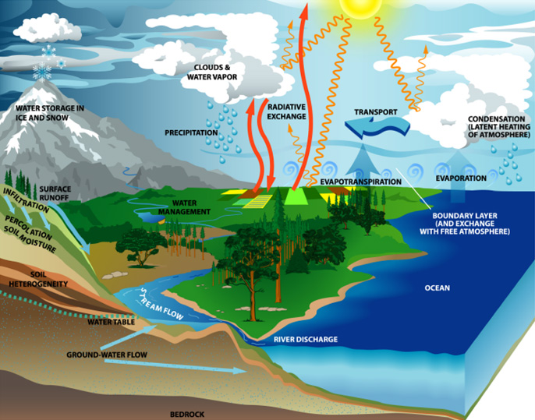

Slide 6
Ground water – water from precipitation that seeps underground and collects in aquifers.
Aquifer – An underground formation of porous rock that collects or holds ground water.

Slide 7
As water moves down into the earth it dissolves small amounts of rock.
Precipitation that ends up in rivers and lakes is known as surface water which is the primary source of drinking water.
Surface water – Water in lakes, ponds and rivers.

Slide 9
Physical properties of water
Pure water is colourless, odourless, and tasteless.
Whether or not an object sinks or floats relates to its density compared to water.
Pure water density = 1.0 g / mL

Slide 10
Physical properties of water
Water is unique in the fact that its density decreases when it becomes a solid, this is what causes ice to float. This in turn acts a blanket which prevents the water underneath from freezing and killing all life.

Slide 11
Physical properties of water
Heat capacity is a measure of how much heat it takes to heat one gram of a substance 1 ° C. Water requires 4.18 J of heat to increase the temperature of 1 gram 1 ° C.
This allows water to help control land temperature by acting as a huge heat sink in the summer and a source of warm in the winter.

Slide 12
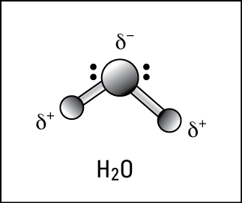
Chemical Properties of Water
Water is a polar molecule that consists of oxygen and hydrogen molecules.
The oxygen has a larger electronegativity and so it creates a partial – charge as it draws hydrogen’s electrons closer to it.

Slide 13
Chemical Properties of Water
The large difference in charge allows for Hydrogen bonding to occur between molecules. This provides water with its unique surface tension, high boiling point and ice that is less dense. (see page 272 fig 5 for diagram)
The polarity of water also allows water to dissolve other polar molecules.
Like dissolves Like

Slide 14
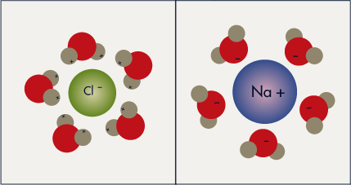
Substances disassociates into charged ions when dissolved in water form electrolytic solutions – conduct electricity

Slide 15
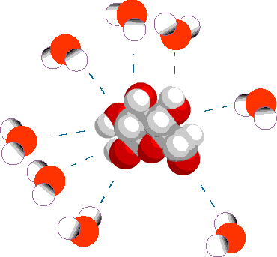
Substances that stay electronically neutral when dissolved in water are called nonelectrolytes. Ex glucose

Slide 16
Due to waters great ability to be a solvent it can become contaminated easily.

Slide 17
Questions
Page 274 # 1, 3, 4 ,5, 6,

Slide 18
Hard Water
Water that contains dissolved calcium, magnesium and iron ions.
When slightly acidic water flows through limestone, calcium, iron, magnesium and manganese irons dissolve in the water at a higher concentration.

Slide 19
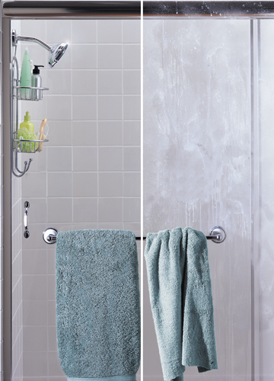
Hard water
Hard water is not dangerous to health but it can change the taste and colour of the water as well as make washing difficult. The soap reacts with the metal ions and forms precipitates which form a scum on the top of the water or in other cases making it difficult to wash the soap off of skin.

Slide 20
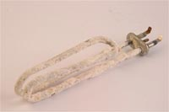
Hard water
Hard water also can deteriorate appliances that heat up water by forming scale deposits on them that prevent the water from contacting the element which decreases the efficiency of the appliance.

Slide 21
Calcium carbonate (limestone rock) reacts with water and carbon dioxide to form calcium bicarbonate which is soluble in water. When heated the reaction reverses leaving calcium carbonate on the heating element.
Ca(HCO_{3­­})_{2(aq)} + heat → CaCO_{2(s)} + H₂O + CO₂

Slide 22
Soft Water
Hardness index (mg/L) or ppm | Water Classification
< 50 | Soft
50 – 200 | Slightly hard
200-400 | Moderately hard
400-600 | Hard
> 600 | Very Hard

Slide 23
Soft Water
Soft water contains very few metal ions.
Hard water can be softened by various methods.
One method is to add a product that will cause the calcium ions to precipitate out of the water.
Home softeners use a resin ion exchange system. Sodium is displaced by calcium and magnesium ions in a single displacement reaction.

Slide 24
Soft water
When all of the sodium ions have been displaced the resin is washed with a high concentration of salt and the sodium displaces the other ions which are washed away.
Soda-lime is also used to soften water at the commercial level. (p 278)

Slide 25
Dissolved Oxygen
Just like land animals, animals that live in the water also need oxygen to survive. Oxygen in the air can dissolve in the water in small amounts. Most oxygen and other gases are dissolved by aeration.
– The process by which agitated water absorbs oxygen from the air.

Slide 26
Anytime the surface tension of water is broken by waves or flowing down a waterfall O₂ is dissolved into the water.

Slide 27
Aquatic plants undergo photosynthesis which also adds O₂ to the water.
Explosions in bacteria populations can dramatically reduce the amount of dissolved oxygen which can lead to the death of fish and other organisms.

Slide 28
Questions
Page 279 # 1-3, 5-9

Slide 29
What’s in Polluted Water?
As the amount of human activity increases the amount of contaminants found in nearby water also increase. Contaminants are classified into three types.

Slide 30
1. Physical Contaminants
Objects that do not dissolve in water. Ex – oil, plastic, tree branches, leaves, peat, silt.
The removal of physical contaminants is the first step in water purification.
Most physical contaminants can easily be removed because they retain their physical properties which allow them to be physically removed by filters.
Chemical means can also be used to remove the contaminants by forming precipitates which can then be filtered off.

Slide 31
2. Biological Contaminants
Biological contaminants include bacteria and viruses which may make the water unsafe to consume.
These contaminants can be removed by various methods such as UV light, filters, other bacteria and chemical means that can kill the contaminants.

Slide 32
3. Chemical Contaminants
Chemicals that are soluble in water. Ex – metal ions, pesticides, fertilizers.
Chemicals that are sprayed, thrown out and spilled contaminate the water. Some of these contaminants can kill things directly while others like phosphorus can cause algae blooms which consume all of the dissolved oxygen and make the water unsafe to use.

Slide 33
What you Can Do
Most household cleaners, paints, batteries, and CFLs contain hazardous chemicals and should not be disposed of in a landfill. Chemicals labelled as corrosive, flammable, reactive, or toxic should be disposed of at specialized sites.

Slide 34
Everyday things you can do to reduce water contamination
Reduce, reuse, recycle
Throw out trash in properly labelled bins
Pick up garbage
Avoid overuse of pesticides, herbicides, and chemical cleaners
Dispose of hazardous chemicals properly

Slide 35
Questions
Page 284 # 1, 2, 4, 5

Slide 36
Acids and Bases

Slide 37
Arrhenius Model of Acids and Bases
Arrhenius Model of Acids and Bases The classical, or Arrhenius, model was developed by Svante Arrhenius in the nineteenth century.
He defined an acid as any substance that liberates or yields hydrogen ions (H+) or protons in water.

Slide 38
Arrhenius Model of Acids and Bases
H⁺ ions are really just a short form for Hydronium ions which are a water molecule with a hydrogen ion bonded to it. (H₃O⁺)

Slide 39
An example would be hydrogen chloride, HCl, gas, which when put in water ionizes to yield hydrogen ions, H+, and chloride ions.
The resulting water solution of ionized H+ and Cl- is known as hydrochloric acid.
Ionization reaction =
HCl_{(g)} + H₂O ↔ H₃O⁺_{(aq)} + Cl⁻_{(aq)}
Simplified ionization reaction =
HCl_{(g)} ↔ H⁺_{(aq)}+ Cl⁻_{(aq)}

Slide 40
This process involving the breakdown of a substance into ions is known as ionization.
Ionization – a reaction in which electrically neutral molecules (or atoms) produce ions.

Slide 41
Arrhenius base
An Arrhenius base is a substance that dissociates in water to produce hydroxide ions, OH-.
Two examples of strong, or almost completely dissociated bases are potassium hydroxide, KOH, and sodium hydroxide, NaOH or lye.
KOH_{(s)} + H₂O_{(l)} ↔ K⁺_{(aq)} + OH⁻_{(aq)} + H₂O_{(l)}

Slide 42
Most solutions formed by the reaction of polar molecular compounds with water are observed to have either acidic or basic properties.

Slide 43
Properties of Acids and Bases
Acids | Acidic Properties | Bases | Basic Properties
• are water soluble • are electrolytes | • taste sour • Inflict a sharp burning pain • turn blue litmus red • neutralize basic solutions • react with active metals to produce hydrogen gas | • are water soluble • are electrolytes | • taste bitter • feel slippery • turn red litmus blue • neutralize acidic solutions

Slide 44
Strong versus Weak
Strong acids are ones that dissolve completely into their ions. HCl, and HNO3 are strong acids. Weak acids only partially ionize and are usually organic in nature like oxalic acid, citric acid, ascorbic acid and vinegar, etc.
Strong acid
HCl_{(aq)} + H₂O_{(l)} → H₃O⁺_{(aq)} + Cl⁻_{(aq)}
100% dissociated - all the HCl breaks down into ions.

Slide 45
Strong acid
HCl_{(aq)} + H₂O_{(l)} → H₃O⁺_{(aq)} + Cl⁻_{(aq)}
100% dissociated - all the HCl breaks down into ions.
Weak acids
HCH₃COO_{(l)} + H₂O_{(l)} → H₃O⁺_{(aq)} + CH₃COO⁻_{(aq)} + HCH₃COO_{(aq)}
1.3 % dissociated - For every 1000 molecules of vinegar dissolved in water only 13 actually break down into ions. The rest remain as complete molecules. This means that the number of hydrogen ions released into the water is much smaller.

Slide 46
Concentrated versus Dilute
Concentrated and dilute are relative terms about concentration.
Dilute simply means that there is less solute dissolved per unit volume than that of a concentrated solution.
We can say things like, this solution is more or less concentrated than some other solution.

Slide 47
Remember from the last unit that concentration is measured as:
concentration = amount of solute volume of solvent

Slide 48
Strong and weak acids can be either concentrated or dilute.
Usually the concentration in chemistry is mol/L but any units can be used like g/100 mL, ppm etc.

Slide 49
Hydrogen Ion and Hydroxide Ion Concentrations
The ion concentrations depend upon two things: 1) does the dissolved substance ionize completely and 2) how much substance actually dissolved?

Slide 50
We will consider several examples to explain the process:
Determine the concentration of hydrogen or hydroxide ions in each of the following solutions of strong acids or bases.
(Because they are strong we can assume 100% ionization)

Slide 51
Example a
a) 0.333 mol/L HNO₃(aq)
Step 1 Write the balanced Ionization equation
HNO_{3(aq)} → H⁺_{(aq)} + NO₃⁻_{(aq)}
Step 2 Determine Molar ratios of Reactants and Products
From the balanced equation, we know that 1 mol of HNO_{3(aq)} ionizes to produce 1 mol of H⁺_{(aq)} ions and 1 mol of NO₃⁻_{(aq)} ions .

Slide 52
Step 3 Use molar ratios to determine concentration of hydrogen or hydroxide ions.
HNO_{3(aq)} → H⁺_{(aq)} + NO₃⁻_{(aq)}
0.333mol/ L 0.333mol/ L 0.333mol/ L
0.333 mol/L of HNO_{3(aq)} x( 1 mol H⁺_{(aq)})
( 1 mol HNO_{3(aq)} )
= 0.333 mol/L of H⁺

Slide 53
Therefore, 0.333 mol/L of nitric acid dissociates into 0.333 mol/L of H⁺ ions and 0.333 mol/L of NO₃⁻ ions.

Slide 54
Example b
b) 5.0 mol/L HI_{(aq)}
Step 1 Write the balanced Ionization equation
HI_{(aq)} → H⁺_{(aq)} + I⁻_{(aq)}
Step 2 Determine Molar ratios of Reactants and Products
From the balanced equation, we know that 1 mol of HI_{(aq)} ionizes to produce 1 mol of H⁺_{(aq)} ions and 1 mol of I⁻_{(aq)} ions .

Slide 55
Step 3 Use molar ratios to determine concentration of hydrogen or hydroxide ions.
HI_{(aq)} → H⁺_{(aq)} + I⁻_{(aq)}
5.0 mol/ L 5.0 mol/L 5.0 mol/ L
5.0 mol/L of HI_{(aq)} x ( 1 mol H⁺_{(aq)­­})
( 1 mol HI_{(aq)} )
= 5.0 mol/L of H⁺

Slide 56
Therefore, 5.0 mol/L of HI dissociates into 5.0 mol/L of H⁺ ions and 5.0 mol/L of I⁻ ions.

Slide 57
Questions: page 300 # 1- 4

Slide 58
pH: Power of Hydrogen
The pH scale is actually based on pure water which is considered to be perfectly neutral. As it turns out water self ionizes. The equation for this self-ionization of water is below.
H₂O_{(l)} + H₂O_{(l)} → H₃O⁺_{(aq)} + OH⁻_{(aq)}

Slide 59
The concentration of H₃O⁺ and OH⁻ are both 1.0 X 10⁻⁷ mol/L. This can be converted into a pH of 7.

Slide 60
This is just proving how it works to DO NOT worry about this or let it confuse you.
The pH scale is out of 14 and 1.0 X 10⁻⁷ X 1.0 X 10⁻⁷ = 1.0 X 10⁻¹⁴. This is not a coincidence.

Slide 61
The pH scale is a logarithmic scale. The p" factor" is defined as the log of the molar concentration of whatever follows the letter p and then multiplied by a negative
So the pH = -log[H⁺]
For strong acid molar concentrations equal to or less than 1, the pH value would have a value from 0-14.

Slide 62
If the Hydrogen ion concentration is 0.1 moles/liter
Then the [OH⁻] could be found by the equation above:
[OH⁻] = 1 X 10⁻¹⁴ / 1 X 10⁻¹ = 1 X 10⁻¹³
The pOH = -log[OH⁻] = -log(1 X 10⁻¹³) = -(log 1 + log 10⁻¹³) = -(0 + -13) = -(-13) = 13

Slide 63
For a [H⁺] = 0.1 = 1 X 10⁻¹
Then pH = -log 1 X 10⁻¹ = -(0 + -1) = 1
Therefore the pH + pOH = 14

Slide 64
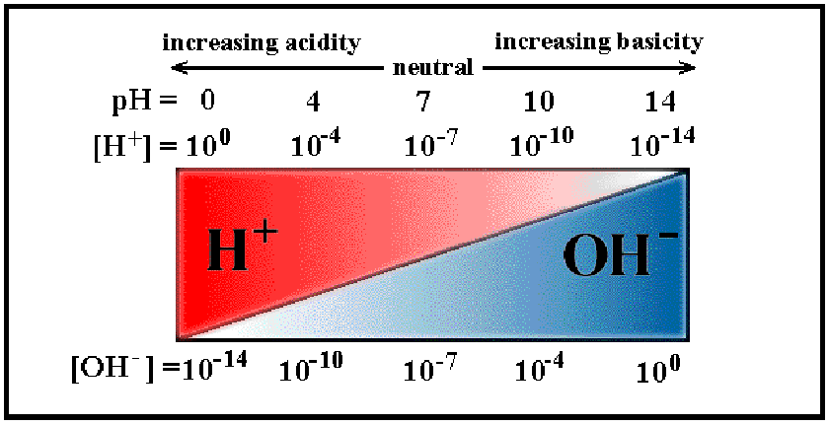
pH scale

Slide 65
Examples:
Calculate the pH of a solution that has a [OH⁻] = 1 X 10⁻⁵ M
1. Determine pOH
pOH = - log [OH⁻ ] = - [log 1 X 10⁻⁵ ] = +5
2. Determine the pH knowing that
pH + pOH = 14
pH = 14 - pOH = 14 - 5 = 9

Slide 66
Strong acids and bases
Typical strong acids: HCl, HBr, HI, HNO₃, H₂SO₄, HClO₄
Strong Bases: All the Hydroxide compounds of Group 1 and Group 2 metals
LiOH, NaOH, KOH, etc and Be(OH)₂, Ca(OH)₂, Mg(OH)₂, etc

Slide 67
Example
What would be the [OH⁻] of a 0.2 M NaOH solution?
NaOH + H₂O → Na⁺_{(aq)} + OH⁻_{(aq)}
0.2 M NaOH will produce 0.2 M OH⁻ since the breakdown is 100%

Slide 68
Example
What would be the [OH⁻] of a 0.3 M Ca(OH)₂
Ca(OH)₂ + H₂O → Ca⁺² _{(aq)} + 2 OH⁻ _{(aq)}
0.3 M Ca(OH)₂ will produce 0.6M OH⁻ because for every one Ca(OH)₂ that breaks apart TWO OH⁻ ions are produced (twice as much) (look at the equation and note the coefficients)

Slide 69
To summarize
If you are calculating pH or pOH you will be given concentration
Type in –log [concentration] = pH
pH + pOH = 14
If you are calculating concentration from pH
Type in 10^{^[-pH]}

Slide 70
Practice Problem
Now here is an example for you to work out.
Given 0.02M Ba(OH)₂ solution:
Determine the Hydroxide ion molar concentration
Determine to pOH
Determine the pH
Determine the Hydrogen ion concentration

Slide 71
1. Determine the Hydroxide ion molar concentration
Step 1
Ba(OH)_{2(aq)} → Ba²⁻_{(aq)} + 2 OH⁻_{(aq)}
Step 2
0.02 M of Ba(OH)₂ x (2 mol OH⁻)
(1 mol Ba(OH­)₂)
= 0.04M of OH⁻
Therefore, 0.02 Molar concentration of barium hydroxide would produce a molar concentration of 0.04 M of OH⁻.

Slide 72
2. Determine pOH
pOH = - log [OH⁻ ] = - [log 4 X 10⁻² ] = 1.4

Slide 73
3. Determine the pH
Determine the pH knowing that pH + pOH = 14
pH = 14 - pOH = 14 – 1.4 = 12.6

Slide 74
4. Determine the hydrogen ion concentration
[H⁺] = 10^{-pH}
Substitute pH value into the equation
[H⁺] = 10^{-12.6} = 2.51 x 10 ⁻¹³M

Slide 75
Question: page 303# 5,6 Page 304 # 1-13
Notes:
Ended here

Slide 76
Acid Base Reactions

Slide 77
Acid and Bases Reactions (316-321)
Acids and bases have a number of characteristic chemical reactions.
1. Acids react with active metals to produce hydrogen gas and a salt of the metal and acid. Fe_{(s)} + 2 HCl_{(aq)} --> H_{2(g)} + FeCl_{2(aq)}

Slide 78
2. Acids react with carbonates to produce a salt and hydrogen carbonate. The hydrogen carbonate immediately decomposes into carbon dioxide and water. 2 HCl_{(aq)} + Na₂CO_{3(aq)} → 2 NaCl_{(aq)} + H₂CO_{3(aq)} H₂CO_{3(aq)} → H₂O_{(l)} + CO_{2(g)}
2 HCl_{(aq)} + Na₂CO_{3(aq)} → 2 NaCl_{(aq)} + H₂O_{(l)} + CO_{2(aq)}

Slide 79
3. Acids react with a base to form salt and water.
When an acid and a base of equal strength are mixed they react to form products that have a pH of near or at 7, this is defined as a neutralization reaction. A Neutralization reaction always produces a salt and water.

Slide 80
The products of a neutralization reaction of an acid and a base are salt and water.
Acid + Base → Salt + water

Slide 81
Neutralization example
Hydrochloric acid + sodium hydroxide → sodium chloride + water
HCl_{(aq)} + NaOH_{(aq)} → NaCl_{(aq)} + H₂O_{(l)}

Slide 82
Neutralization reactions
During a Neutralization reaction, the hydrogen ion from the acid reacts with the hydroxide ion from the base to form water.
H⁺ + OH⁻ → HOH
= H₂O
The salt from the reaction is dissolved in the water to form a salt solution which is neutral.
There are many types of salts formed; NaCl is just one of many.

Slide 83
Questions: page 318 # 1-3

Slide 84
Acid Base Titrations

Slide 85
A titration is a common method in quantitative chemical analysis. A known volume of a sample to be analysed is titrated against a known concentration of a base.

Slide 86
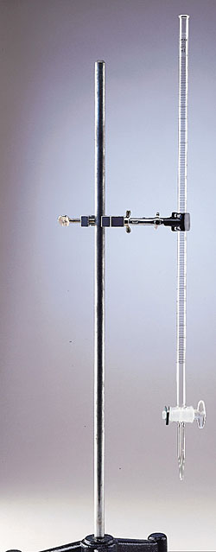
The burette contains an accurately known concentration called the standard solution. During the titration, the solution is the burette called the titrant, is added drop by drop.

Slide 87
When the solution reaches the endpoint, where equal concentrations of acid and base have been mixed a chemical indicator signals that neutralization is complete.

Slide 88
Sample Quantitative Analysis Using a Titration
There are two methods in which this can be done; both will give you the correct answer.
Example Analysis:
The concentration of hydrochloric acid can be analysed by titration with sodium hydroxide solution. Three 10.0 mL sample of HCl are titrated with a standardized 0.200 mol/L solution of sodium hydroxide. The results for the three trials are shown below. What is the concentration of the hydrochloric acid?

Slide 89
Results from titration
Trial | 1 | 2 | 3 | Average
Final Burette Reading | 13.85 mL | 26.95 mL | 39.85 mL
Initial Burette Reading | 0.70 mL | 13.90 mL | 26.90 mL
Volume of NaOH(aq) added | 13.15 mL | 13.05 mL | 12.95 mL | 13.05 mL

Slide 90
Method 1 (text book)
Step 1: write a balanced chemical equation for reaction, and list given values
HCl_{(aq)} + NaOH_{(aq)} → NaCl_{(aq)} + H₂O_{(l)}
V_{HCl} = 10.0 mL = 0.0100 L
V_{NaOH} = 13.05 mL = 0.01305 L
C_{NaOH}­ = 0.200 mol/L

Slide 91
Method 1 (text book)
Step 2: Calculate the amount of moles of standard solution required for complete reaction.
c = n / v n = c x v | n_{NaOH} = V_{NaOH} x C_{NaOH} n_{NaOH} = (0.01305 L x 0.200 mol/L) = 0.00261 mol

Slide 92
Method 1 (text book)
Step 3: From balanced equation, determine the amount of Moles of titrant required for complete reaction.
1 mol of NaOH_{(aq)} requires 1 mol of HCl_{(aq)} for a complete reaction. Ratio = 1:1
n_{NaOH} = n_{HCl} = 0.00261 mol

Slide 93
Method 1 (text book)
Step 4: Calculate concentration of Titrant.
c = n / v | c_{HCl} = n_{HCl} / v_{HCl} c_{HCl} = 0.00261 mol / 0.0100 L = 0.261 mol / L Therefore, the concentration of the hydrochloric acid is 0.261 mol / L

Slide 94
Method 2 (less work) but more math
Same question
Example Analysis: The concentration of hydrochloric acid can be analysed by titration with sodium hydroxide solution. Three 10.0 mL sample of HCl are titrated with a standardized 0.200 mol/L solution of sodium hydroxide. The results for the three trial are shown below. What is the concentration of the hydrochloric acid?

Slide 95
Method 2
Results from titration
Trial | 1 | 2 | 3 | Average
Final Burette Reading | 13.85 mL | 26.95 mL | 39.85 mL
Initial Burette Reading | 0.70 mL | 13.90 mL | 26.90 mL
Volume of NaOH(aq) added | 13.15 mL | 13.05 mL | 12.95 mL | 13.05 mL

Slide 96
Method 2
We will make use of the following equation: M_{a}•V_{a}•C_{a} = M_{b}•V_{b}•C_{b}
M_{a} is the molarity of the acid,
M_{b} is the molarity of the base
V_{a} is the volume of acid used,
V_{b} is the volume of base used
C_{a} is the number of acidic hydrogens in the acid,
C_{b} is the number of hydroxides in the base. This takes the mole ratio into account

Slide 97
Fill in the following known’s M_{a} = ?
M_{b} = 0.200 mol/L V_{a} = 10.0 mL
V_{a} = 13.05 mL (experimentally determined)
C_{a} = 1
C_{b} = 1

Slide 98
Rearrange the titration equation to find M_{a}.
M_{a}•V_{a}•C_{a} = M_{b}•V_{b}•C_{b} rearranges to give
M_{a}•V_{a}•C_{a} = M_{b}•V_{b}•C_{b} V_{a}•C_{a} V_{a}•C_{a}
M_{a} = M_{b}•V_{b}•C_{b} V_{a}•C_{a}

Slide 99
M_{a} = M_{b}•V_{b}•C_{b} V_{a}•C_{a}
M_{a} = 0.200 mol/L • 13.05 mL • 1 10.0 mL • 1
= 0.261 mol/L for the HCl

Slide 100
Questions: page 323 # 1-8
Read page 324

