Slide 1
Electric Potential Difference aka Voltage
Lesson 10

Slide 2
Electric Potential Difference
Charge does not flow on its own. An electric charge has a certain amount of electrical potential energy because of the electric field set up by the power supply.
Work is done by the power supply to increase the electric potential energy of each coulomb of charge from a low to a high value.
As the charge flows through the load, its energy decreases.

Slide 3
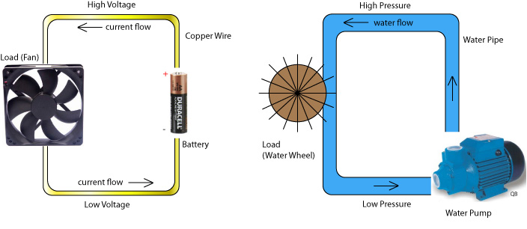
A load converts electrical energy into another form of energy. You can compare this to the water flowing past a water wheel. The wheel converts some of the energy of the water into motion. The water has more energy before the wheel than after the wheel.

Slide 4
The electrical potential energy for each coulomb of charge in a circuit is called the electric potential difference (V). Aka Voltage
E
V
Q

Slide 5
Quantity | Symbol | Units of measurement
Charge | Q | C (coulomb)
Energy | E | J (Joules)
Voltage | V | V (Volts)

Slide 6
Where E is the energy required to increase the electric potential of a charge, Q. Potential difference is often called voltage.

Slide 7
The formula can be rearranged
Energy
Charge

Slide 8
One volt (V) is the electric potential difference between two points if one joule of work (J) is required to move one coulomb (C) of charge between the points.
Joules ∕Coulombs = Volts

Slide 9
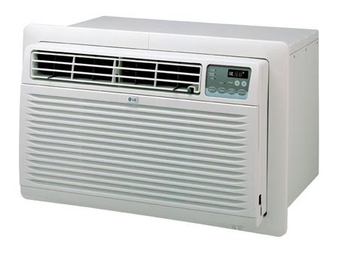
Example 1: potential difference and energy
What is the potential difference across an air conditioner if 72 C of charge transfers 8.5 x 10³ J of energy to the fan and compressor?
Q = 72 C
E = 8.5 x 10³ J
V = ?

Slide 11
V = 1.2 x 10² V
Therefore, the potential difference or voltage in the air conditioner is 1.2 x 10² V

Slide 12
Example 2: Energy and potential difference
A static electric shock delivered to a student from a “friend” transfers 1.5 x 10¹ J of electric energy through a potential difference of 500 V. What is the quantity charge transferred in the spark?
E = 1.5 x 10¹ J
V = 500 V
Q = ?

Slide 14
Q = 0.03 C
Therefore, the charge transfer between friends is 0.03 C.

Slide 15
Recall that and
So E = VQ and Q = It
Therefore, E = VIt

Slide 16
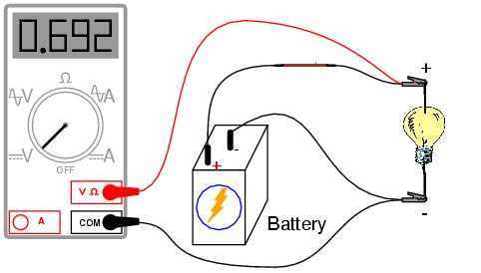
Measuring Potential Difference
Potential difference between any two points can be measured using a voltmeter. A voltmeter must be connected in parallel with a load in the circuit in order to compare the potential before and after the load.

Slide 17
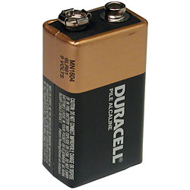
Supplying Electrical Energy
Electrical energy always originates from some other form of energy.
Some common sources include:
Voltaic cells – Chemical potential energy released during a reaction as electrons are driven between two different metals

Slide 18
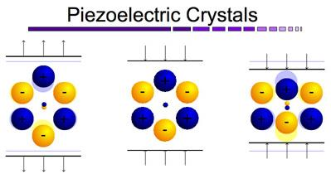
Piezo-electricity – Crystals that produce a small electric potential when a mechanical force is placed on them.

Slide 19
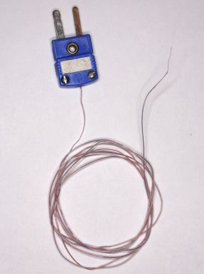
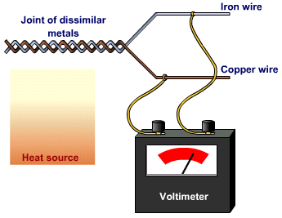
Thermoelectricity – Two different types of metal joined together and subjected to temperature differentials.

Slide 20
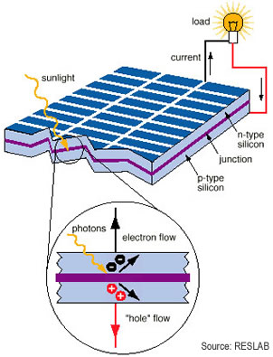
Photo electricity – Light energy absorbed by electrons of certain metals causes charge flow.

Slide 21
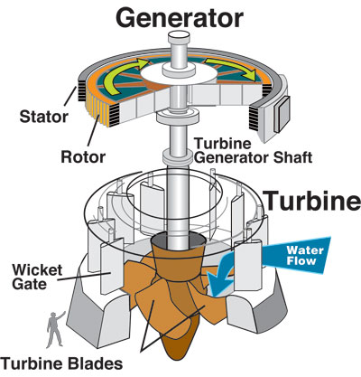
Electromagnetic induction in generators – Kinetic energy forces conductors to rotate in a magnetic field.

Slide 22
Voltage in Series and parallel Circuits
Kirchhoff’s Voltage Law – The total of all electric potential difference in any complete circuit loop is equal to any potential increases in the circuit loop.
The potential increase, V_{T} is equivalent to the sum of all the potential losses so that
V_{T} = V₁ + V₂ + V₃
V₁
V_{T}
V₃
V₂

Slide 23
Voltage according to Kirchhoff’s law, this series circuit has one voltage increase of 100V. This voltage must be distributed so that the sum of all voltage drops for each individual resistor must equal this value.
V₁
V_{T}
V₃
V₂

Slide 24
Find V₂
V_{T} = V₁ + V₂ + V₃
So V₂ = V_{T} – V₁ – V₃
V₂ = 100 V – 30 V – 30 V
= 40 V
30 V
10.0 A
10.0 A
10.0 A
R₁
100v
R₂
30 V
V₂
I₃

Slide 25
Example 2: Kirchhoff’s laws in a parallel circuit
V_{T} = V₁ = V₂ = V₃
Voltage – The voltage increase is 30 V, thus there must be a decrease for each of the three different parallel resistor paths. Therefore, The voltage drop across all three parallel resistors is 30 V, no matter what their resistances.

Slide 26
Find V₂
V_{T} = V₁ = V₂ = V₃
V₂ = 30 V
9.0 A
R₂
R₃
30V
V₂
30V
30V
R₁
I₃
3.0 A
3.0 A

Slide 27
Complete lab page 562

