Slide 1
Animal cells
Lesson 5
February 4-7th, 2011

Slide 2
Although animal cells are different from plant cells, the two types of cells have many organelles in common.

Slide 3
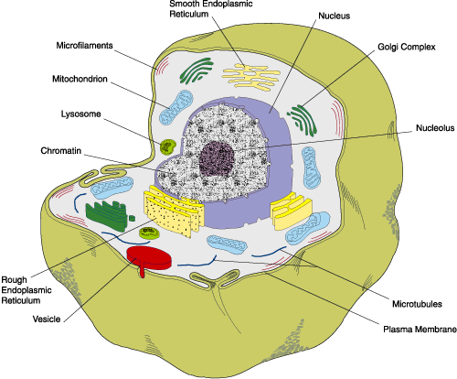
Copy the terms and definitions into the blank table below the picture of the cell

Slide 4
Cell Membrane
Controls what goes in and out of the cell

Slide 5
Cell Membrane
Controls what goes in and out of the cell

Slide 6
Nucleus
Controls all the activities of the cell

Slide 7
Mitochondrion
Produces energy in the cell

Slide 8
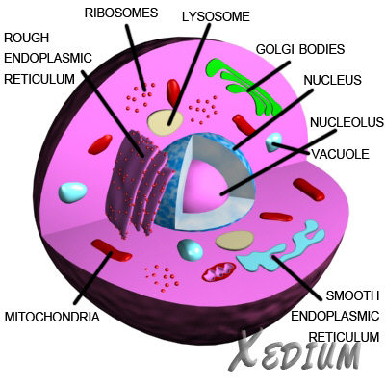
Vacuole
Stores food, water, and waste in the cell

Slide 9
Endoplasmic Reticulum (ER)
Transports food, water, and waste around the cell

Slide 10
Cytoplasm
A jelly like substance that holds all the organelles in place.

Slide 11
For the diagram above, colour each organelle listed on the page. Also, be sure to colour in the square beside the name of the organelle.

Slide 12
Using your notes, answer the questions on the second page.

Slide 13
Viewing Unicellular animals
Protists are made up of one cell. For this reason, they are celled unicellular animals. “Uni” refers to the number 1. Protists carry out some of the same activities that you do, such as eating, moving and responding to the environment.
You will make three drawings.
Please draw to the best of your ability.
Take your time.

Slide 14
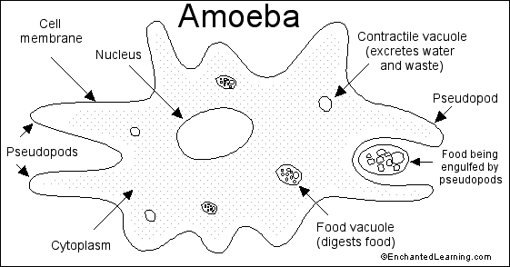

Slide 15
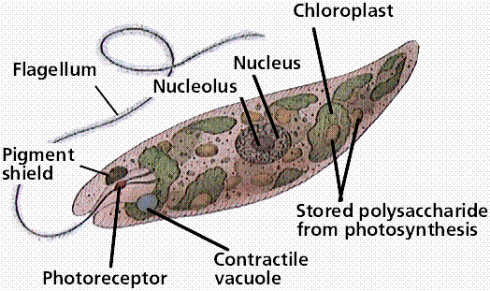

Slide 16
