Slide 1
conductors and insulators
SNC1P

Slide 2
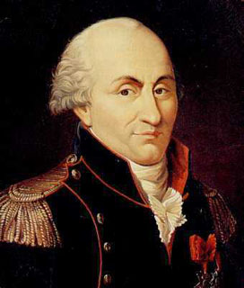
Coulombs
Charles-Augustin de Coulomb was a French physicist who worked with electric charges and made several important discoveries.

Slide 3
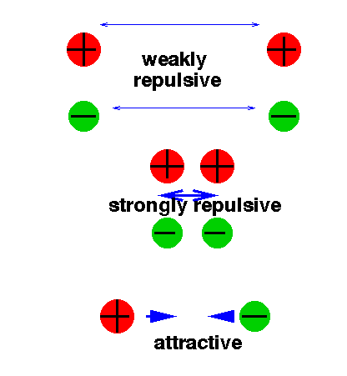
1. When two charged objects are placed closer together, the attraction or repulsion increases.
2. When the charged objects are moved farther apart, the attraction or repulsion decreases.

Slide 4
In his honour, the metric unit for electric charge is named the coulomb (C).
One coulomb equals 6.24 x 10¹⁸ electrons added to or removed from a neutral object.

Slide 5
Conductors
Another way to group materials is by their conductivity.
Conductivity is the ability of materials to allow electrons to move freely in them.
Conductor

Slide 6
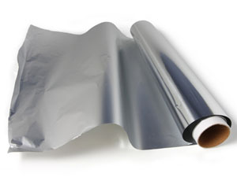
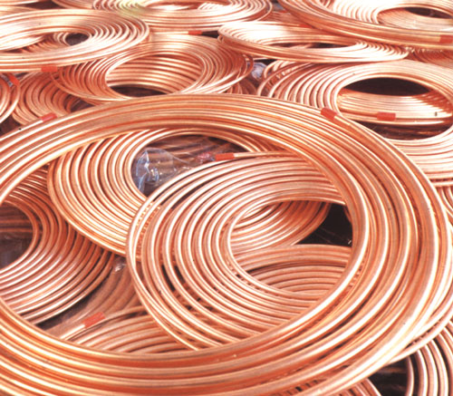
Electrical Insulators and Conductors
Materials that allow electrons to change positions are called conductors.
Conduction is the movement or transmission of electrons through a substance.
Examples: metals such copper and aluminum.

Slide 7
Electrical Insulators and Conductors
Materials that hold onto their electrons and do not allow them to move easily are called electrical insulators.
Insulator

Slide 8
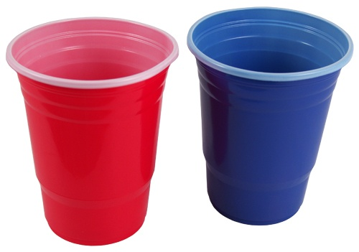
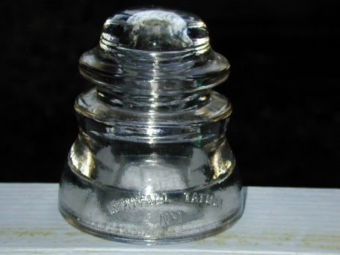
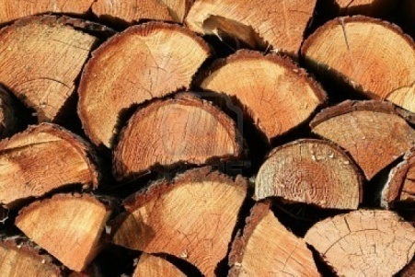
Electrical Insulators and Conductors
An electrical insulator is a solid, liquid, or gas that resists or blocks the movement of electrons.
    Example: Dry wood, glass, and plastic.
An insulator can hold a
static charge because
static charges remain
nearly fixed in place.

Slide 9
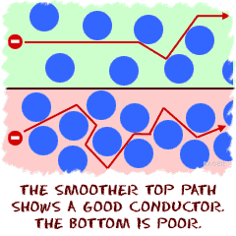

Slide 10
Electrical Insulators and Conductors
Materials that only allow some movement of electrons are called Fair Conductors.
  the electrons do not move as freely as in a conductor, but they are not held almost in place as they are in an insulator

Slide 11
Conductivity of selected materials
Conductors | Fair Conductors | Insulators
Copper | Water with dissolved minerals | Rubber
Aluminum | Moist Air | Wood
Iron | Human Body | Plastic
Mercury | Carbon | Pure Water
Other metals | Soil | Metal oxides such as rust

Slide 12
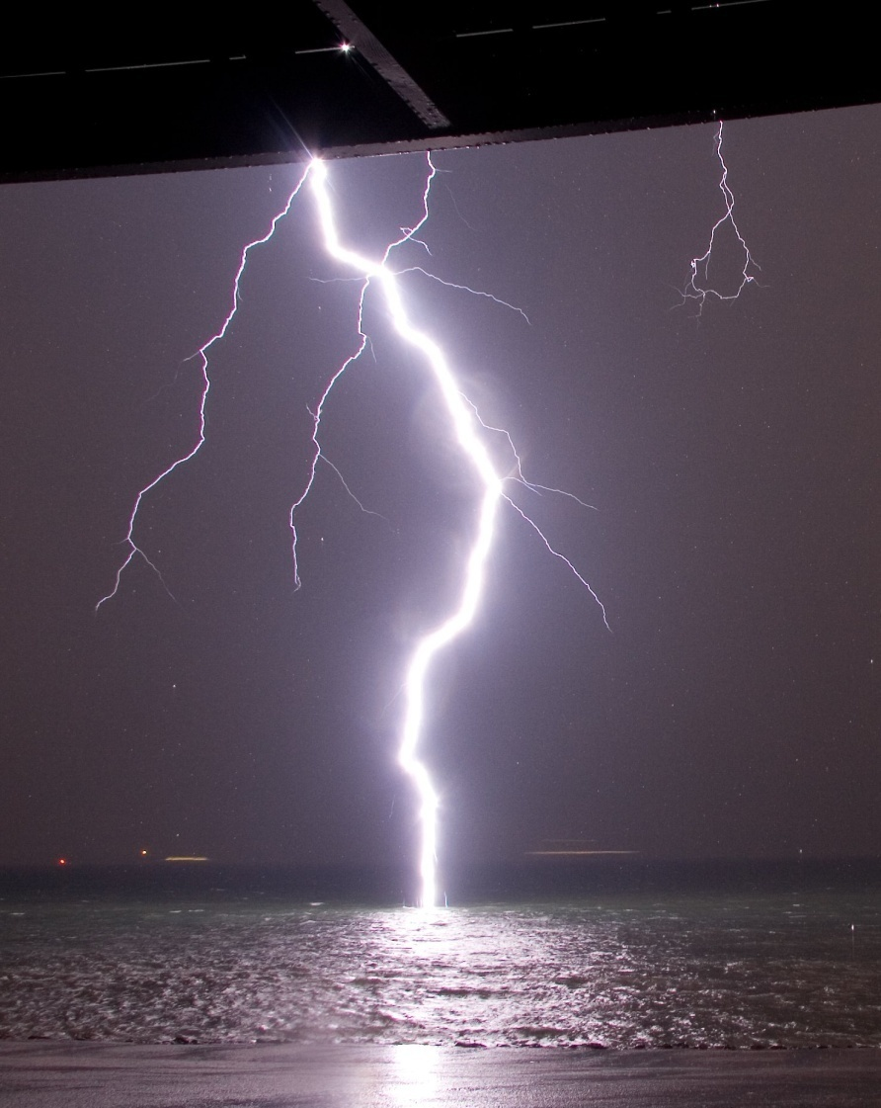
Water as a Conductor
Water is an insulator only if it is pure.
Most water has dissolved minerals in it, so its conductive properties change and it becomes a fair conductor.

Slide 13
Water as a Conductor
Do not copy
  This is why you do not want to be in a lake during a thunderstorm.
  This also why you should not use water to try to put out an electrical fire.
  You also need to take care not to operate electrical appliances near water or with wet hands

Slide 14
Hands on lab
Obtain the following
  Electricity kit
    DO NOT MIX KITS
    ONE for every 3 students
Find out what conducts in the classroom
Make a Table and write down what does conduct and what does not.
  Are their similarities between things that conduct and things that don’t?

