Slide 1
Unit 3 Review: Physics

Slide 2
Static charges accumulate on surfaces and remain there until given a path to escape

Slide 3
Key Concepts
• Static electric charges
• Law of attraction and law of repulsion
• Conductors and insulators
• Charging by friction
• Charging by contact and induction
• Using and reducing static charges

Slide 4
Electric charges are charged particles that exert an electric force on each other.
  Charged particles are very small but when they are present in large enough quantities they can produce sparks just large enough to feel or large enough to kill.

Slide 5

Electrically Charged Particles
Within an atom, there are three types of smaller particles:
  Protons have a positive electric charge (+)
  Electrons have a negative electric charge (–).
  Neutrons have no electric charge, they are neutral.

Slide 6
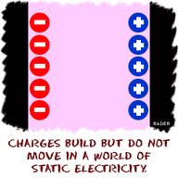
Static Charges
Objects can become charged when electrons move from one object to another.
The electric charge that builds up on the surface of the object is called a static charge or static electricity.

Slide 7
Electron Affinity
The table on the left is known as a triboelectric series
Tribo in Greek means to rub

Slide 8
Friction
    Friction is the force resisting the relative motion of two surfaces in contact. The force of friction can remove electrons from one object and cause them to transfer to the other object.

Slide 9

Laws of Attraction and Repulsion
Scientists studying the interaction of objects have observed that when a positively charged object is brought close to a negatively charged object, the two objects attract each other

Slide 10

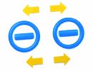
Laws of Attraction and Repulsion
objects with the same charge are placed close together, the objects repel each other.

Slide 11
Electrical Insulators and Conductors
Materials that hold onto their electrons and do not allow them to move easily are called electrical insulators.
  An electrical insulator is a solid, liquid, or gas that resists or blocks the movement of electrons.
    Example: Dry wood, glass, and plastic.
An insulator can hold a static charge because static charges remain nearly fixed in place.

Slide 12
Electrical Insulators and Conductors
Materials that allow electrons to change positions are called conductors.
Conduction is the movement or transmission of electrons through a substance.
Examples: metals such copper and aluminum.

Slide 13
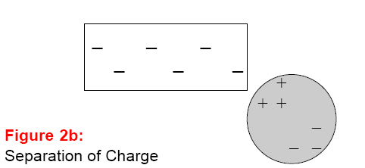
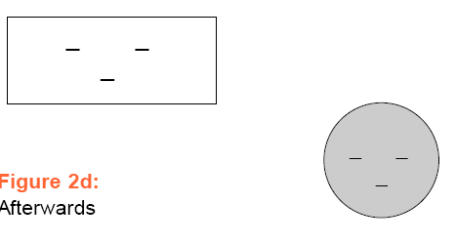
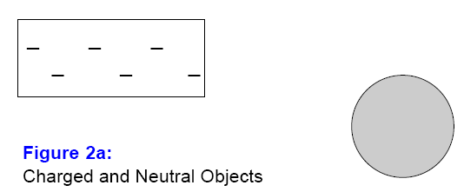
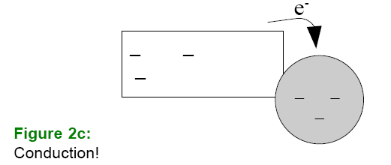
Charging By Contact
Electrons can be transferred through contact and conduction.
You can charge a neutral object by contact when you touch it with a charged object.
Charging by contact occurs when electrons transfer from the charged object to the neutral object that it touches.

Slide 14
Charging by Induction
When charging an object by induction, a charged object is used to induce a charge in a neutral object and then ground the charged object so it retains the charge.
This newly charged object has the opposite charge to the charge on the charging object.

Slide 15
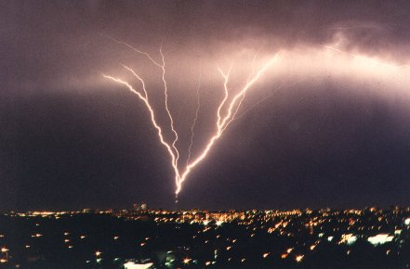
Lightning Rods
The main purpose of a lightning rod is to provide a point removed from the main structure of a building where a stream of electrically charged particles is more likely to form.
If lightning hits the lightning rod, the flow of electrically charged particles is directed harmlessly down to the ground so the building is not damaged.

Slide 16
Summary
• Objects that gain electrons become negatively charged. Objects that lose electrons become positively charged.
• Objects with like charges repel each other. Objects with unlike charges attract each other.

Slide 17
Summary
• When an object is charged by contact, it takes the same charge as the charging object.
• When an object is charged by induction, it takes the opposite charge to the charging object.

Slide 18
Summary
• Charged objects attract neutral objects through the process of induction.
• The principles of electrostatics are used in applications such as photocopying, spray painting, and filtering air.

Slide 19
Key Terms
Read each one and then try to define it, if you do not know the meaning of it look it up in your notes and write it down.

Slide 20
Current electricity is the continuous flow of electrons in a closed circuit.

Slide 21
Key Concepts
• Current electricity
• Electrical circuits
• Potential difference
• Electric current
• Direct current
• Alternating current
• Resistance
• Series circuits and parallel circuits
• Ohm’s law (V = IR)
• Electrical safety

Slide 22
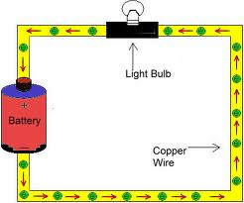
2. The electrons will not flow unless they have a complete path to flow through.
  This path is called an electrical circuit.
The continuous flow of electrons in a circuit is called current electricity.

Slide 23
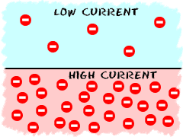
Current
Current is the rate of charge flow and is given the symbol I. Current is the total amount of charge moving past a particular point in a conductor divided by the time taken.

Slide 24
Measuring Current
Current in a circuit is measured using an ammeter.
The unit of electric current is the ampere (A).
An ampere is a measure of the amount of charge moving past a point in the circuit every second.

Slide 25
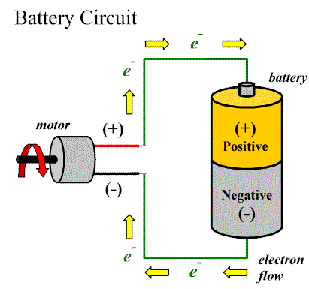
Forms of Current Electricity
There are two ways that we can produce current electricity.
Direct Current (DC)
Electrons flow from the negative terminal to the positive terminal.
  Example- Battery.
  Draw this diagram in the blank
  Square provided

Slide 26
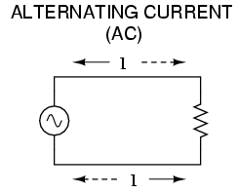
Forms of Current Electricity
Alternating Current (AC)
Electrons move back and forth, alternating their direction many times every second.
AC is used in more applications than DC as it is more efficient when traveling long distances.
AC is used in all homes and work places.

Slide 27

Calculating Current
Q
I
t

Slide 28
Electric Circuits
A circuit includes:
1. Energy source – battery or generator
2. Conductor – allows the current to move through the circuit

Slide 29
Load - a device that converts electrical energy to another form of energy.
Example: Light bulb, motor, heater, etc. The figure below shows a light bulb as the load. It converts electrical energy to light and heat

Slide 30
Switch (optional) - a device that turns the circuit on or off by closing or opening the circuit.
When the switch is closed, the circuit is complete and electrons can flow.

Slide 31
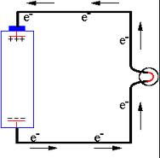
Potential Difference
If a conductor, such as a copper wire, is connected to both terminals, then the electrons flow from the negative terminal to the positive terminal.
The difference in electric potential energy between two points in a circuit is called the potential difference or voltage (V).

Slide 32
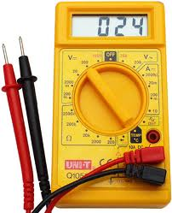
Measuring Potential Difference
The potential difference between two locations in a circuit is measured with a voltmeter.

Slide 33
The electrical potential energy for each coulomb of charge in a circuit is called the electric potential difference (V). Aka Voltage

Slide 34
Resistance
The degree to which a substance opposes the flow of electric current through it.
All substances resist electron flow to some extent.

Slide 35
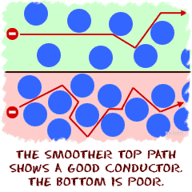
Resistance
  Conductors, such as metals, allow electrons to flow freely through them and have low resistance values.
  Insulators resist electron flow greatly and have high resistance values.

Slide 36
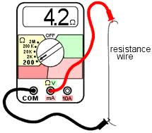
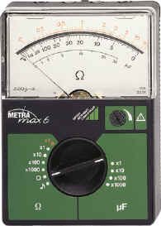
Resistance
Resistance is measured in ohms (Ω) using an ohmmeter.
An ohmmeter is a device for measuring resistance.
Ohmmeters are connected in parallel

Slide 37
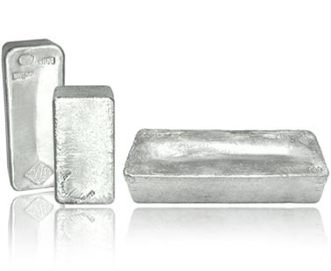
Factors that Affect the Resistance of a Wire
Factor | How Factor Affects Resistance
Material | Silver has the least resistance but very expensive to use in wires. Most Conducting wires are made from copper

Slide 38
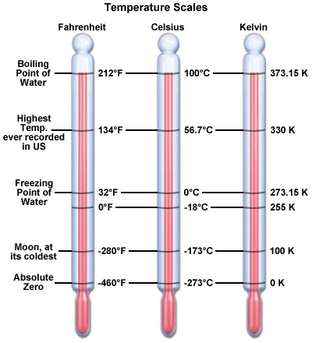
Factors that Affect the Resistance of a Wire
Factor | How Factor Affects Resistance
Temperature | As the temperature of the wire increases, its resistance increases and its conductivity decreases. In other words, a colder wire is less resistant than a warmer wire.

Slide 39
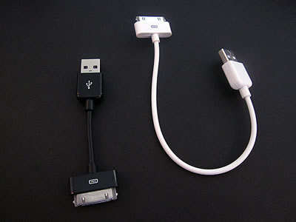
Factors that Affect the Resistance of a Wire
Factor | How Factor Affects Resistance
Length | Longer wires offer more resistance than shorter wires. If the wire doubles in length, it doubles in resistance

Slide 40
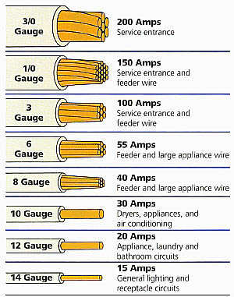
Factors that Affect the Resistance of a Wire
Factor | How Factor Affects Resistance
Cross-sectional Area | Wider wires offer less resistance than thinner wires. If the wire doubles in width, its resistance is half as great. Conducting wires that carry large currents need large diameters to lessen their resistance.

Slide 41
Series Circuits
An electric circuit in which the components are arranged one after another in series.
A series circuit has only one path along which electrons can flow.
    If that pathway is interrupted, the whole circuit cannot function.

Slide 42
Parallel Circuits
A parallel circuit is an electric circuit in which the parts are arranged so that electrons can flow along more than one path.
The points where a circuit divides into different paths or where paths combine are called junction points
An interruption or break in one pathway does not affect the other pathways in the circuit.

Slide 43
Summary of Current, potential difference, and resistance in series and parallel circuits.
Circuit | Potential Difference
Series circuit | Each load uses a portion of the total potential differences supplies by the battery V_{T} = V₁ + V₂ + V₃

Slide 44
Summary of Current, potential difference, and resistance in series and parallel circuits.
Circuit | Potential Difference
Parallel circuit | Each load uses all the potential difference supplied by the battery. V_{T} = V₁ = V₂ = V₃

Slide 45
Summary of Current, potential difference, and resistance in series and parallel circuits.
Circuit | Current
Series circuit | The current is the same throughout a series circuit I_{total} = I₁ = I₂ = I₃

Slide 46
Current in a series circuit example
I_{T} = I₁ = I₂ = I₃
I₃ = 10 A
30 V
10.0 A
10.0 A
10.0 A
R₁
100v
R₂
V₂
30 V
I₃

Slide 47
Summary of Current, potential difference, and resistance in series and parallel circuits.
Circuit | Current
Parallel circuit | The current divides into different paths. A pathway with less resistance will have a greater current I_{total} = I₁ + I₂ + I₃

Slide 48
Current in a parallel circuit example
I_{T} = I₁ + I₂ + I₃ = 9 A
I₃ = I_{T} – I₁ – I₂ = 9 A – 3 A – 3A
= 3A
9.0 A
R₂
R₃
30V
V₂
30V
30V
R₁
I₃
3.0 A
3.0 A

Slide 49
Units of electrical energy
Energy- The ability to do work
Electrical Energy- The energy transferred to an electrical load by moving charges.
  The symbol for electrical energy is E and the SI unit for measuring energy is called the joule. 1 joule is a very small amount of energy so we use Watt hour and Kilowatt hour.
1 watt hour = 3600 joules.
1 kilowatt hour = 1000 watt hours

Slide 50
Calculating Electrical Energy
Energy = Power x Time
kWh kW h
Total Energy Used = Speed That Electricity is used x How long electricity is used

Slide 51
Calculating Percent Efficiency
An incandescent light bulb uses only about 5 percent of its input energy to create light and converts over 95 percent of its input energy into heat.
Compact fluorescent lights transform about 20 percent of their energy input into light, so they are more efficient than incandescent light bulbs

Slide 52
The efficiency of a device is the ratio of the useful energy that comes out of the device to the total energy that went in. The more input energy that a device converts into usable output energy, the more efficient the device is.
Efficiency is usually calculated as a percentage.

Slide 53

Comparing Efficiency
If an appliance displays the Energy Star symbol, it is one of the most efficient appliances in its class.

Slide 54
Summary
• Electrical circuits provide a complete path for electrons to flow.
• Current electricity is the flow of electrons through a conductor in a circuit.
• Potential difference or voltage (V ) is the difference in electric potential energy between two points in a circuit.

Slide 55
Summary
• Electric current (I ) is a measure of the amount of electric charge that passes by a point in an electric circuit each second.
• In direct current, electrons flow in one direction. In alternating current, electrons flow back and forth at regular intervals called cycles.
• Resistance (R) is the degree to which a substance opposes the flow of electric current through it.

Slide 56
Summary
• Series circuits provide one path for electrons to flow. Parallel circuits provide more than one path for electrons to flow.
• Ohm’s law states that as long as temperature stays the same, V = IR

Slide 57
We can reduce our electrical energy consumption and use renewable energy resources.

Slide 58
Key Concepts
• Generating electricity
• Renewable and non-renewable sources of energy
• Advantages and disadvantages of energy sources
• Percent efficiency = (E_{out} / E_{in}) x 100%

Slide 59
Local Solutions to Generating Electricity
The production of energy can be classified into two categories:
Non-renewable resources.
  A resource that cannot be replaced once it is used up.
Renewable resources.
  A resource that can be reused or replaced.

Slide 60
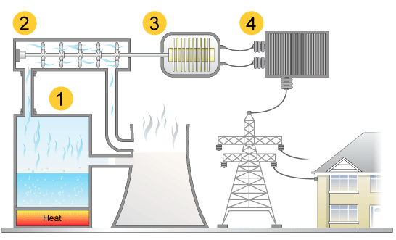
Fossil Fuels
the fuel is burned to boil water to make steam
the steam makes a turbine spin
the spinning turbine turns a generator which produces electricity
the electricity goes to the transformers to produce the correct voltage

Slide 61
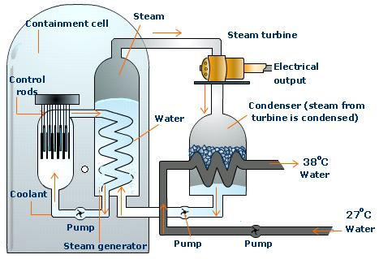
Nuclear Energy
Ontario’s electrical energy needs far surpass what hydroelectric and thermoelectric generators supply. Fifty-one percent of our electricity in Ontario is thermonuclear, which means it is produced by heat in nuclear power stations.

Slide 62
Summary
• Non-renewable sources used for generating electricity include fossil fuels and nuclear energy.
• Renewable sources used for generating electricity include water, sunlight, wind, tides, and geothermal energy.

Slide 63
Summary
• There are both costs and benefits from producing electricity from renewable and non-renewable sources.
• Electrical savings can be achieved through the design of technological devices and practices in the home.

Slide 64
Practice Questions
The questions have been split up into the sections that we covered in electricity

