Slide 1
Resistance
SNC1P

Slide 2
Resistance
The degree to which a substance opposes the flow of electric current through it.
All substances resist electron flow to some extent.

Slide 3
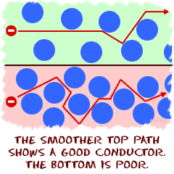
Resistance
Conductors, such as metals, allow electrons to flow freely through them and have low resistance values.
Insulators resist electron flow greatly and have high resistance values.

Slide 4
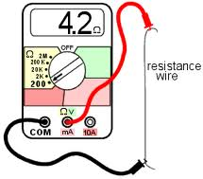
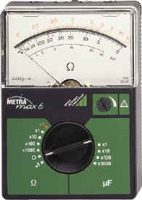
Resistance
Resistance is measured in ohms (Ω) using an ohmmeter.
An ohmmeter is a device for measuring resistance.
Ohmmeters are connected in parallel

Slide 5
Resistance
When a substance resists the flow of electrons, it slows down the current and converts the electrical energy into other forms of energy.
The more resistance a substance has, the more energy gained by the substance is radiated to its surroundings as heat and/or light energy

Slide 6
Resistance in a Circuit
A resistor is any material that can slow current flow.
In a light bulb, the filament’s high resistance to the electron’s electrical energy causes it to heat up and produce light.

Slide 7
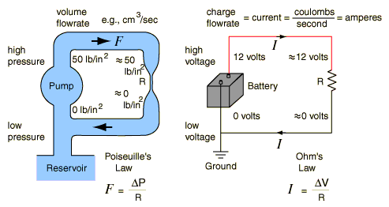
Resistors and Potential Difference
Resistors can be used to control current or potential difference in a circuit.
In a circuit, electrons have a higher potential difference as they enter a resistor compared to when they leave the resistor because they use up some energy in passing through the resistor.

Slide 8
Example:
Imagine electrons entering a resistor as being at the high end of a ramp, where they have a lot of potential energy. In this analogy, electrons leaving the resistor are at the bottom end of the ramp, where their potential energy has been converted to another form of energy

Slide 9
Types of Resistors
Resistors can be made with a number of techniques and materials
The two most common types are wire-wound and carbon-composition.

Slide 10
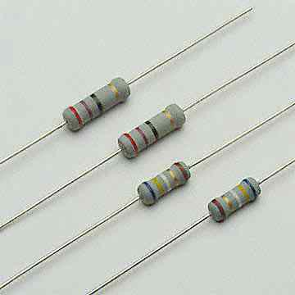
wire-wound resistor
A wire-wound resistor has a wire made of heat-resistant metal wrapped around an insulating core. The longer and thinner the wire, the higher the resistance. They are available with values from 0.1Ω up to 200 k Ω

Slide 11
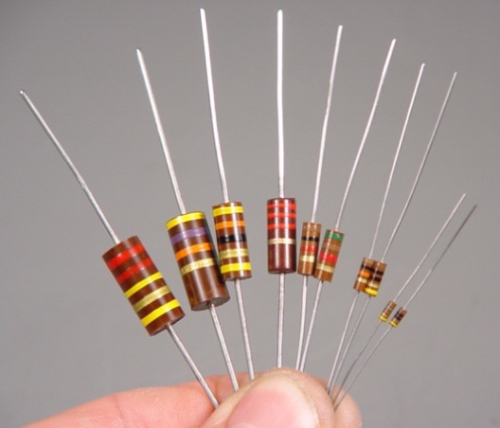
Carbon-composition resistors
Carbon-composition resistors are made of carbon mixed with other materials. The carbon mixture is moulded into a cylinder with a wire at each end. By varying the size and composition of the cylinder, manufacturers produce resistances from 10 Ω to 20 M Ω. Moulded carbon resistors are cheaper to make than wire-wound resistors but less precise.

Slide 12
Resistance in a Wire –comparing water to electricity
Longer thinner pipes have more resistance to the flow of water than pipes with a larger diameter.
The same idea applies to electricity.
The more resistance that you have in a circuit, the more it will decrease current at a given potential difference.

Slide 13
Larger, shorter wires provide less resistance for electrons to travel.
Temperature and material can also affect resistance.

Slide 14
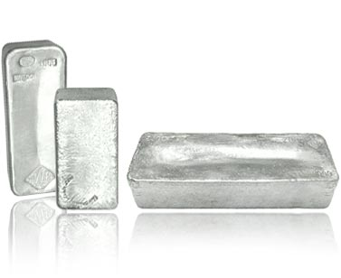
Factors that Affect the Resistance of a Wire
Factor | How Factor Affects Resistance
Material | Silver has the least resistance but very expensive to use in wires. Most Conducting wires are made from copper

Slide 15
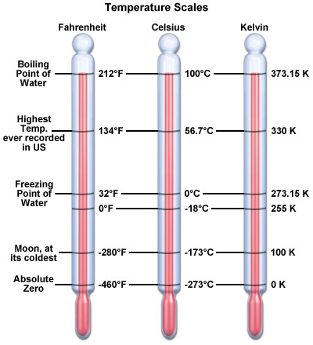
Factors that Affect the Resistance of a Wire
Factor | How Factor Affects Resistance
Temperature | As the temperature of the wire increases, its resistance increases and its conductivity decreases. In other words, a colder wire is less resistant than a warmer wire.

Slide 16
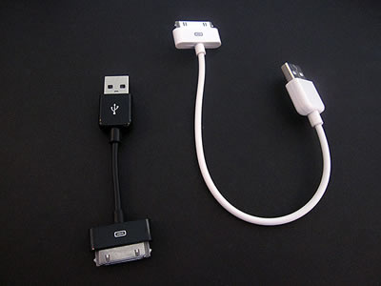
Factors that Affect the Resistance of a Wire
Factor | How Factor Affects Resistance
Length | Longer wires offer more resistance than shorter wires. If the wire doubles in length, it doubles in resistance

Slide 17
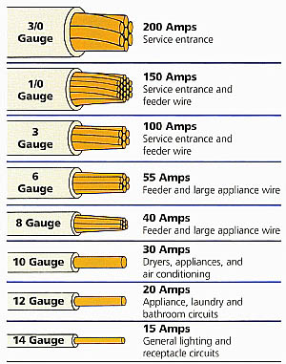
Factors that Affect the Resistance of a Wire
Factor | How Factor Affects Resistance
Cross-sectional Area | Wider wires offer less resistance than thinner wires. If the wire doubles in width, its resistance is half as great. Conducting wires that carry large currents need large diameters to lessen their resistance.

Slide 18
Questions
Questions Page 566 #3,4,5,6,7

