Slide 1
Newton’s Second Law of Motion
Lesson 15
February 8th, 2011

Slide 2
Newton’s Second Law of Motion
If the external force on an object is not zero, the objet accelerates in the direction of the net fore. The magnitude of the acceleration is directly proportional to the net force and inversely proportional to the objects mass.

Slide 3
In other words, if the net force is kept constant, the acceleration decreases as the mass increases.
If the mass is kept constant, the net force is proportional to the acceleration.

Slide 4
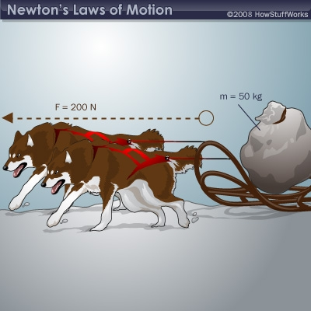

Slide 5
If the units of the net force, acceleration, and mass are all SI units, the second law of motion can be summarized in the equation:
This can be rearranged to

Slide 6
Where is the net force measured in newtons (N),
m is the mass measured in kilograms (kg), and
is the acceleration in meters per second squared (m/s²)

Slide 7
One newton (N) is the magnitude of the net force needed to give a 1 km object an acceleration of magnitude of 1 m/s²
or

Slide 8
Example 1 :
A net force of 58 N [W] is applied to a water polo ball of mass 0.45 kg. Calculate the ball’s acceleration.

Slide 10
Therefore, the ball’s acceleration is 1.3 x 10² m/s² [W]

Slide 11
Example 2:
A sports car traveling initially at 26.9 m/s [S], comes to a stop at 2.61 s. The mass of the car with the driver is 1.18 x 10³ kg. Calculate (a) the car’s acceleration and (b) the net force needed to cause the acceleration.

Slide 13
Therefore, the cars acceleration is 10.3 m/s² [N]

Slide 14
(b)

Slide 16
Therefore, the net force on the car is 1.22 x 10⁴ N [N]

Slide 17
Mass and Weight

Slide 18
Newton’s second law equation
can be applied to objects in free fall near the Earth’s surface.
During the free fall, the net force is and the acceleration is the acceleration due to gravity,
, so the equation is written
, where = 9.8 m/s² [down].

Slide 19
The force of gravity on an object is called weight. Being a force, weight is measured in newtons, not in kilograms.
The force of gravity on an object; it is a vector quantity measured in newtons, symbol
It should be noted that gravity will vary based on its location.

Slide 20
Mass
The quantity of matter in an object, it is a scalar quantity measured in kilograms (kg) in SI.
On Earth’s surface, gravity remains the same and is called the gravitational constant. It has the formula

Slide 21
Example 3:
The maximum train load pulled through the Chunnel, the train tunnel under the English Channel that links England and France, is 2.434 x 10⁶ kg. Determine the weight of this load.

Slide 23
Therefore, the load is 2.4 x 10⁷ N [down]

Slide 24
Questions
Calculate the acceleration of each of the following:
A net force of 27 N [W] is applied to a cyclist and bicycle having a total mass of 63 kg.
A bowler exerts a net force of 18 N [forward] on a 7.5 kg bowling ball.
Calculate the net force in each of the following situations
A cannon gives a 5.0 kg shell an acceleration of 2.4 x 10³ m/s² [E] .
A 28 g arrow is given an acceleration of 2.4 x 10⁴ m/s² [E].

Slide 25
Assume that for each pulse, a human heart accelerates 21 g of blood from 18 cm/s to 28 cm/s during a time interval of 0.10 s. Calculate the magnitude of
The acceleration of the blood
The force needed to cause that acceleration
Calculate the weight of a 19 kg curling stone.
Calculate the force required to raise the curling stone upwards without acceleration.

Slide 26
Calculate the weight of a 54 kg robot on the surface of Venus where the gravitational constant is 8.9 N/kg [down].
Calculate the mass of a backpack whose weight is 180 N [down]
A net force of 5.0 N [S] is applied to a toy electric train of mass 2.5 kg. Calculate the train’s acceleration.
Calculate the net force needed to give a 250 kg boat an acceleration of 2.8 m/s² [W].

