Slide 1
Electric Fields
Lesson 2

Slide 2
Charged Objects
The charge of an object can be measured in Coulombs.
Q = Ne
Where Q is the amount of charge in coulombs,
N is the total number of electrons in either deficit or excess, and
e is the charge on an electron 1.602 x 10⁻¹⁹ C.

Slide 3
Example
A silk shirt is rubbed against a wool sweater; the wool loses 3.7 x 10²⁴ electrons to the silk shirt. What is the charge on either fabric?

Slide 4
N = 3.7 x 10²⁴
e = 1.602 x 10⁻¹⁹ C
Q = ?

Slide 6
Q = 5.9 x 10⁵ C
Therefore, the charge on either the silk or the wools is 5.9 x 10⁵ C

Slide 7
Forces at a distance
Electrostatic forces do not need to be in contact with each other for them to act on each other. In general, the farther the forces are apart from one another the weaker the force.

Slide 8
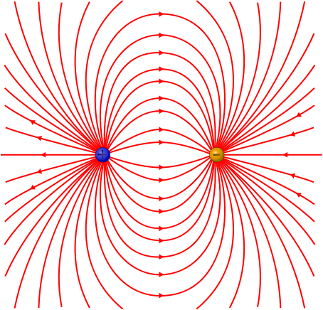
To describe the forces that exist in areas around electrostatic charges, we use a field map which describes an electric field.
A three dimensional space around a single charge or array of charges in which electric forces act.

Slide 9
The quantity that is distributed in an electric field is force.
If a positive test charge is placed inside the electric field of another charge, the two charges will experience a force of attraction or repulsion.
Test charge – a small charge used to check for the presence of an electric field.

Slide 10
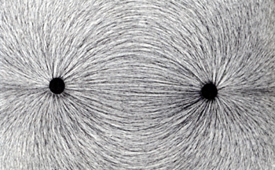
The closer a positive test charge comes to a positive object, the stronger the repulsive force will be. The field map shows the relative value of force strength based on how close the field lines in the map are to each other.
Field Lines – the paths along which a object travels if it is affected by a field

Slide 11
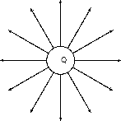
Single Positive charge

Slide 12
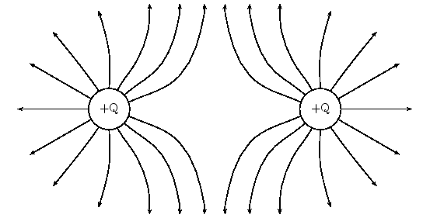
Equal like charges

Slide 13
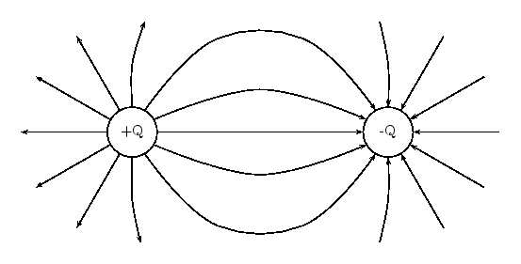
Equal and opposite charges

Slide 14
Lab: Drawing Magnetic Fields Lab
Background
Magnetic fields are easily visualized by sprinkling “iron filings” in the vicinity of the field: the long filing line up along field lines, giving a beautiful visual model of the invisible magnetic field. In the absence of iron filings, a compass may be used as a “magnetic field tester” by placing at different locations where one wants to identify the direction of the magnetic field.

Slide 15
